Slide 1
Committed to Ending Homelessness

Slide 2
Who We Are
JOURNEYS | The Road Home is a non-profit agency providing both shelter and social services to the homeless and those at risk of becoming homeless in north/northwest suburban Cook County.

Slide 3
MISSION
To individually assess and serve the homeless and near homeless, while broadening community awareness and involvement with the homeless.

Slide 4
Service Area
Notes:
JOURNEYS serves 37 villages and townships. Our service area extends from Lake Michigan all the way out to Barrington. It extends south to Elk Grove and north to Buffalo Grove.

Slide 5
Who do we serve?
JOURNEYS provides services to anyone who is without housing or at risk of losing housing in our service area.
**ALL SERVICES ARE FREE**
Notes:
JOURNEYS provides services to anyone who is without housing or at risk of losing housing in our service area. ALL SERVICES ARE FREE. JOURNEYS does not discriminate. Individuals with any type of disability, substance use, or mental health issues are welcome. We also welcome veterans, domestic violence survivors, women, children, LGBTQ+ individuals, and any other sub-population.

Slide 6
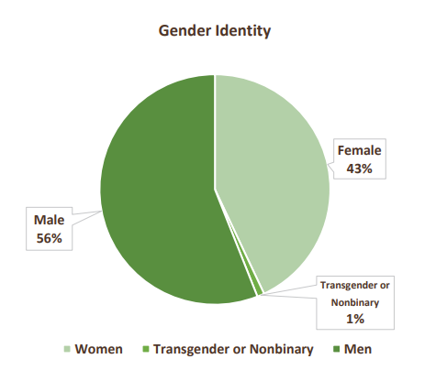
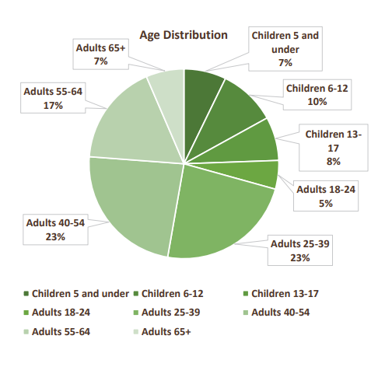
Who do we help?

Slide 7
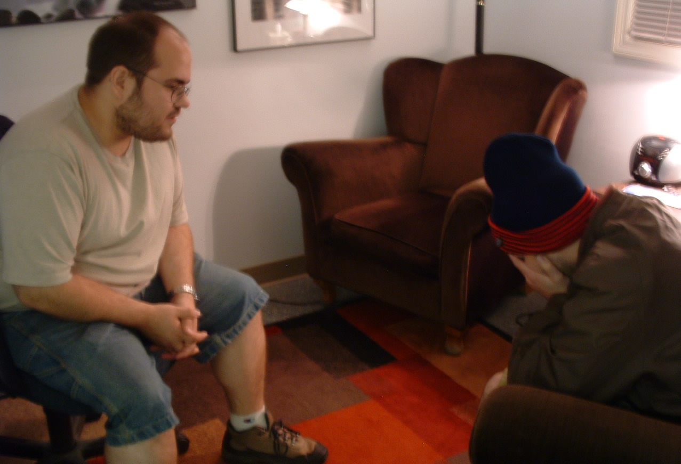
What causes people to experience homelessness?
People without housing fall into three groups:
Short Term Loss of Housing (2 weeks or less)
One Shelter Season Without Housing
Long Term Loss of Housing (1+ yrs.)
Notes:
People without housing generally fall into 3 groups:
-Short Term Loss of Housing (2 weeks or less) – An individual who needs brief shelter before social support kicks in.
-One Shelter Season Without Housing – An individual needs support finding better employment or a new housing situation.
-Long Term Loss of Housing (1+ years) – An individual who needs comprehensive services and usually has profound health issues. These individuals may be in the system for many years due to personal obstacles. Case Managers collaborate on individualized goal plans with these clients.

Slide 8
What do we do?
Hotel Program
During the pandemic JOURNEYS pivoted to hotel shelter to keep clients safe.
PADS
Public Action Demands Shelter partners with local churches to provide shelter nightly.
HOPE Center
This includes services such as the clothing closet, food pantry, and support from case managers.
Pathways Housing Readiness Program
This program helps stabilize clients and adjust to be able to successfully transfer to permanent housing.
Interim Housing
A specialized upcoming shelter program geared towards clients who need more focused care staring in November.
Notes:
JOURNEYS serves those without housing through 3 main programs: the PADS overnight shelter program, the HOPE Center, and the Pathways Housing Readiness Program. All programs are critical parts to moving to stability.

Slide 9
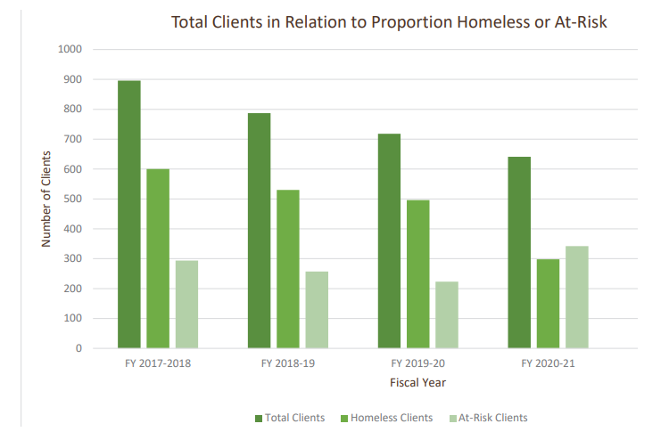
What does it mean to be at risk?
A person or family that is at risk is still housed but is struggling to maintain stable housing.
Notes:
A person or family that is “at risk” is still housed but struggling to maintain their stability. Some of the circumstances that lead to their instability are:
-Single parents living paycheck to paycheck.
-Elderly or disabled people on fixed incomes.
-Being laid off from a job or being unemployed.
-The cost of living increasing while wage stays the same.
The HOPE Center works with these clients by providing services and resources to help supplement their income.

Slide 10
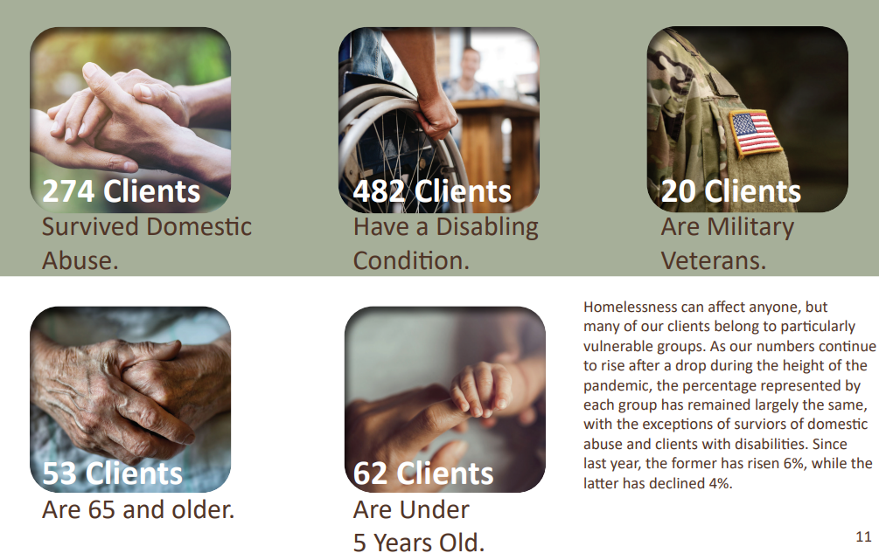
Vulnerable Communities JOURNEYS served in 2021-2022

Slide 12
HOPE Center
1992 HOPE NOW, Inc. was created
1998 Northwest Suburban PADS Inc. & HOPE Now, Inc merged
Monday – Friday, 7:30am – 5:30pm (Weekends are on a week-to-week basis)
GOALS
1. Move into Stable Housing
2. Maintain Stable Housing
3. Find or keep employment or receive employment benefits
Notes:
In 1992 HOPE NOW, Inc. was created. It merged with Northwest Suburban PADS in 1998 to provide both shelter and supportive services to clients. The HOPE Center is a support center open 7:30 a.m. to 4:00 p.m., Monday through Friday. The HOPE Center is drop-in. No appointment is necessary and there is no waiting list for services. At the HOPE Center we work with those without housing and at-risk to set them on a path to a better life. We have three principle goals:
1. First, we get people off the streets and into permanent housing. On average, the HOPE Center moves 2 households per week into permanent housing.
2. Second, we keep people in stable housing, by providing food, clothing, counseling, and healthcare. The HOPE Center helps prevents 10-11 households per week from losing their housing.
3. Third, we help clients improve their employment prospects. The HOPE Center helps 6-7 households per week find or keep employment or get unemployment.

Slide 13
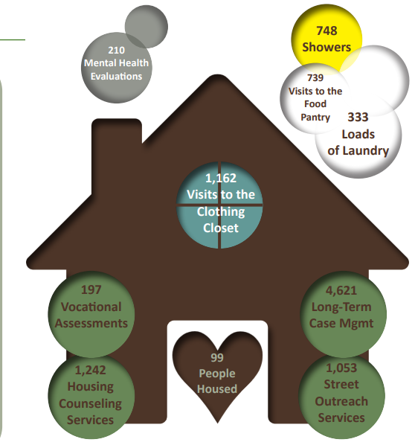
Impact of The Hope Center in 2021-2022

Slide 14
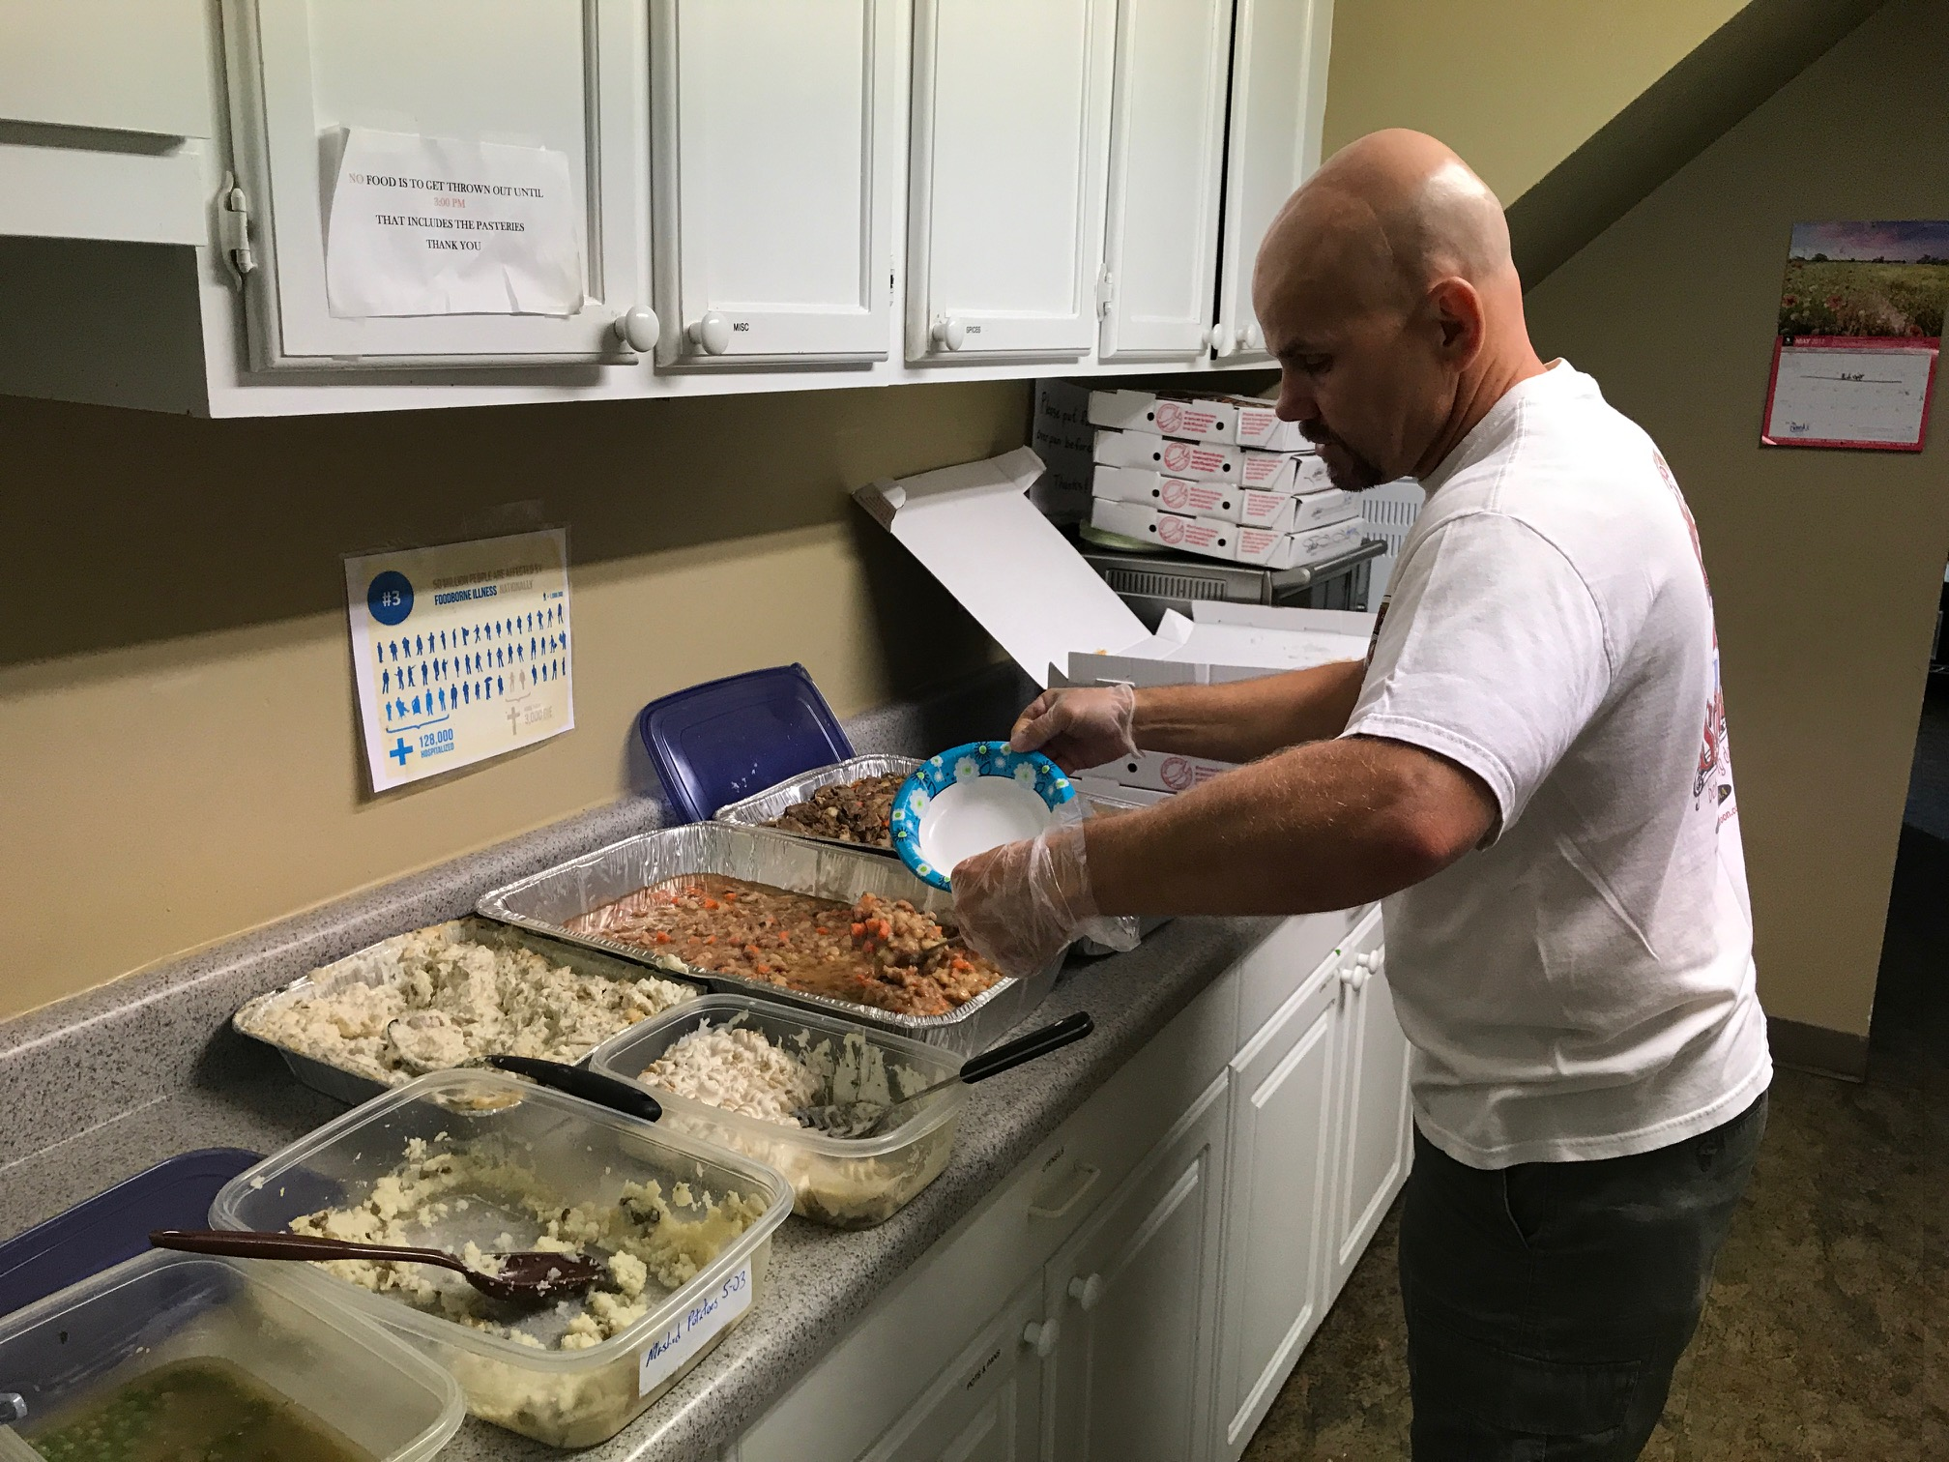
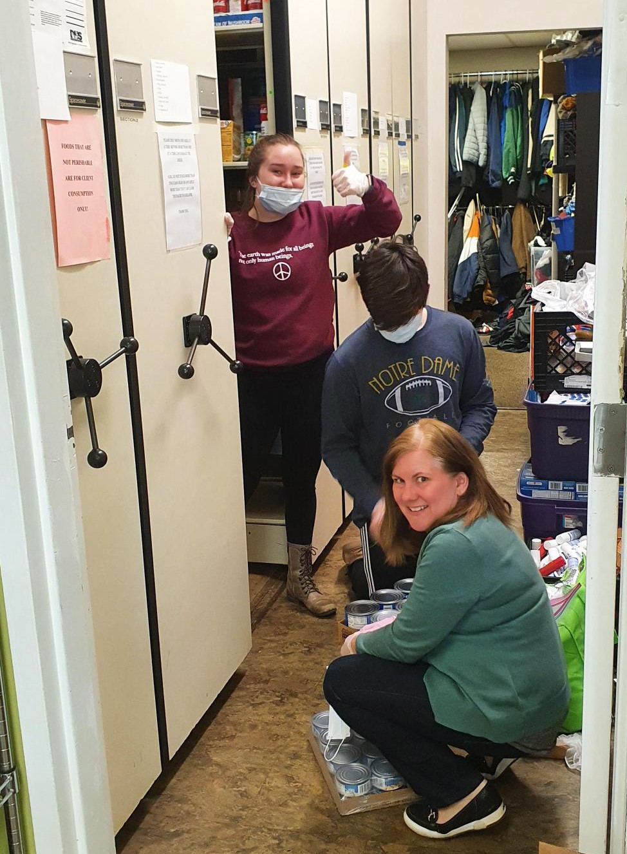
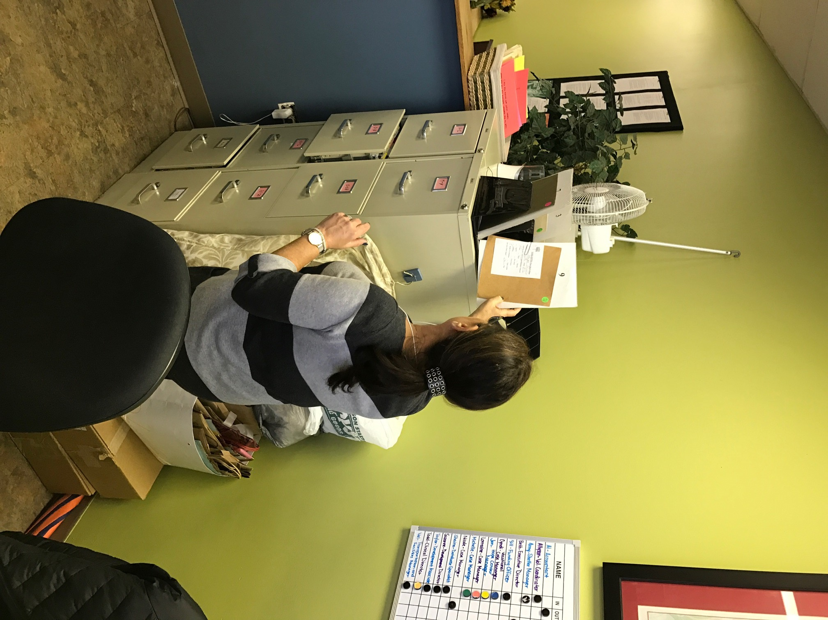
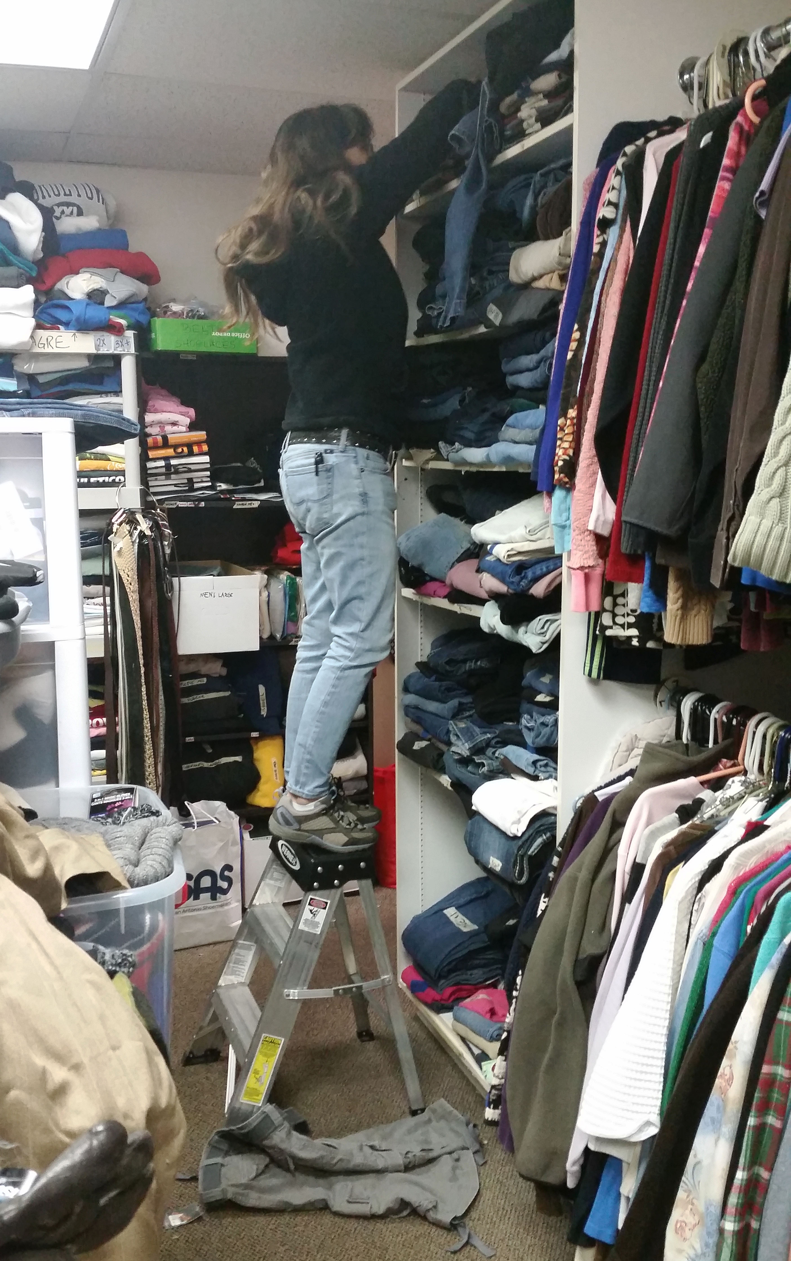
Volunteer at the HOPE Center! With the new building the shifts will be extending to reflect JOURNEYS changing hours
Front Desk Assistant/Kitchen assistants
(3-4 people needed per shift, for each role)
AM Front Desk: 7:30am-12:00pm
PM Front Desk: 12:00pm- 5:30pm
AM Kitchen Assistant: 9:00am- 12:00pm
PM Kitchen Assistant: 12:00pm-3:00pm
Notes:
There are a variety of volunteer opportunities at the HOPE Center that are divided into various shifts.
Front Desk Volunteers help with checking in clients, answering the phone, and other general office tasks – Morning Shift Available – 7:30am – 12:00pm and Afternoon Shift Available 12:00pm – 4:00pm
Kitchen Assistant serves meals throughout the morning– 8:30am – 11:00am
Clothing Closet or Food Pantry Coordinator organizes donations– Flexible Schedule

Slide 15
Volunteer at the HOPE Center! With the new building the shifts will be extending to reflect JOURNEYS changing hours
Clothing Closet or Food Pantry Coordinator
(1-2 people needed per shift, for each role)
AM Clothing Closet/Food Pantry:
9:00am-12:00pm
PM Clothing Closet/Food Pantry:
12:00pm- 3:00pm
Notes:
There are a variety of volunteer opportunities at the HOPE Center that are divided into various shifts.
Front Desk Volunteers help with checking in clients, answering the phone, and other general office tasks – Morning Shift Available – 7:30am – 12:00pm and Afternoon Shift Available 12:00pm – 4:00pm
Kitchen Assistant serves meals throughout the morning– 8:30am – 11:00am
Clothing Closet or Food Pantry Coordinator organizes donations– Flexible Schedule

Slide 16
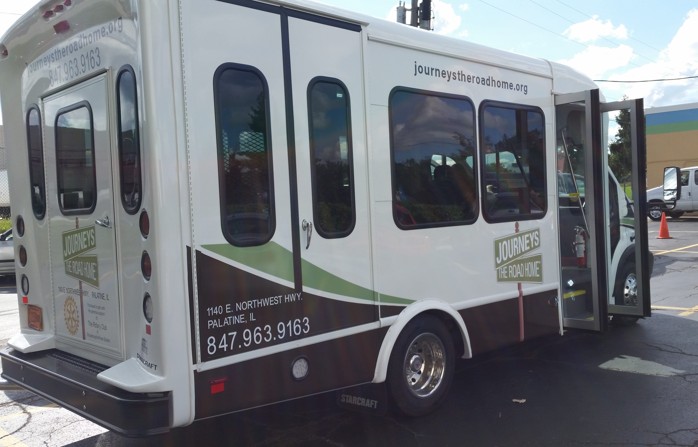
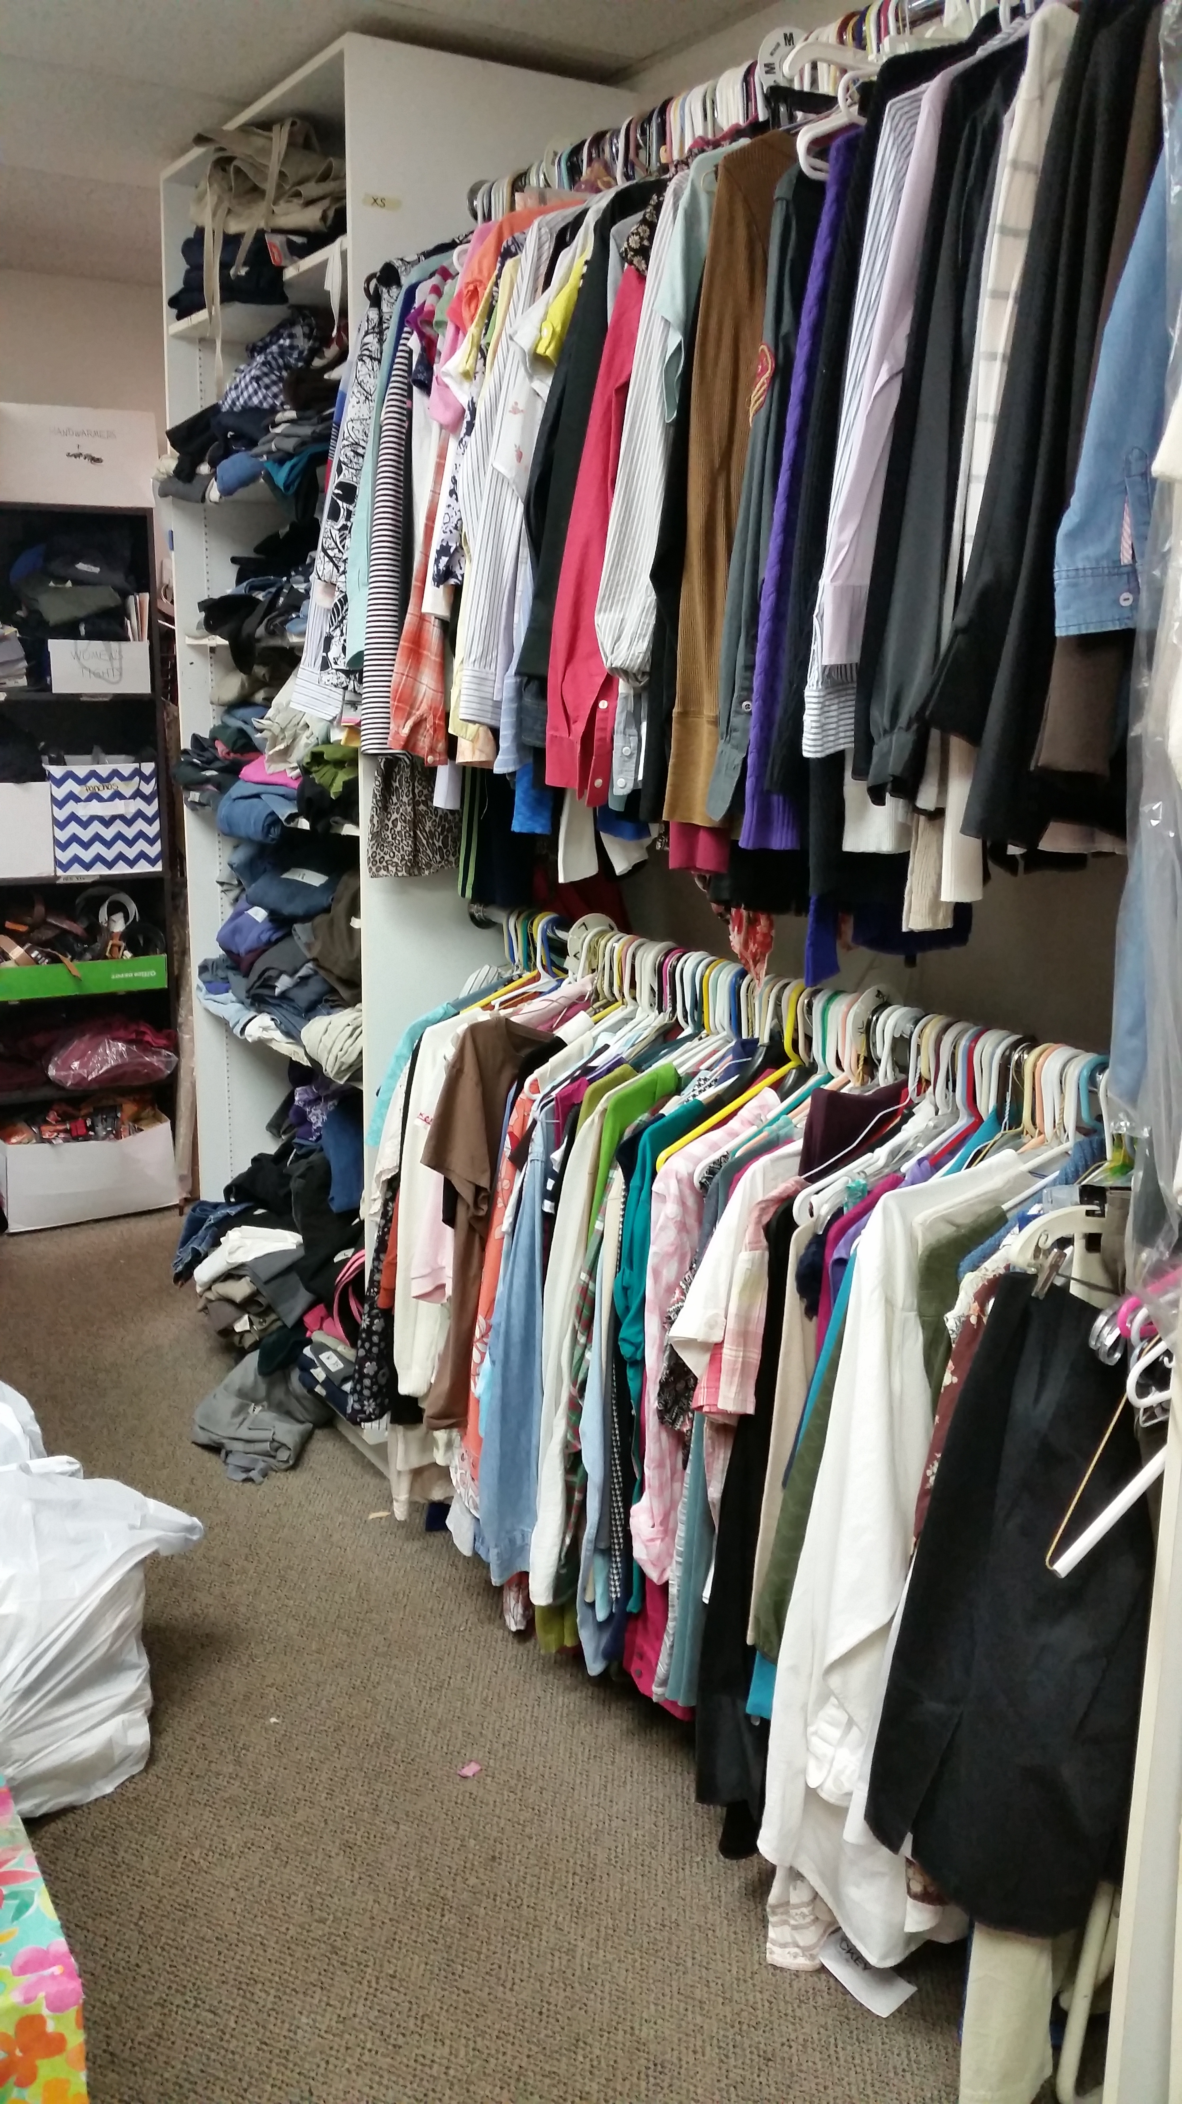
Critical Importance of the HOPE Center: Over 65 Free Onsite Supportive Services
Intensive case management
Mental health counseling
Housing assistance
Vocational counseling
Outreach services
Budgeting &financial stability
New Transportation Program
Occasional travel & food vouchers
Warm meals
Showers, laundry, lockers
Voicemail, email, & mail
Resume design
Job interview practice
Computer skill
Onsite nursing care
Professional referrals
Food pantry
Clothing closet
Bike repair

Slide 17
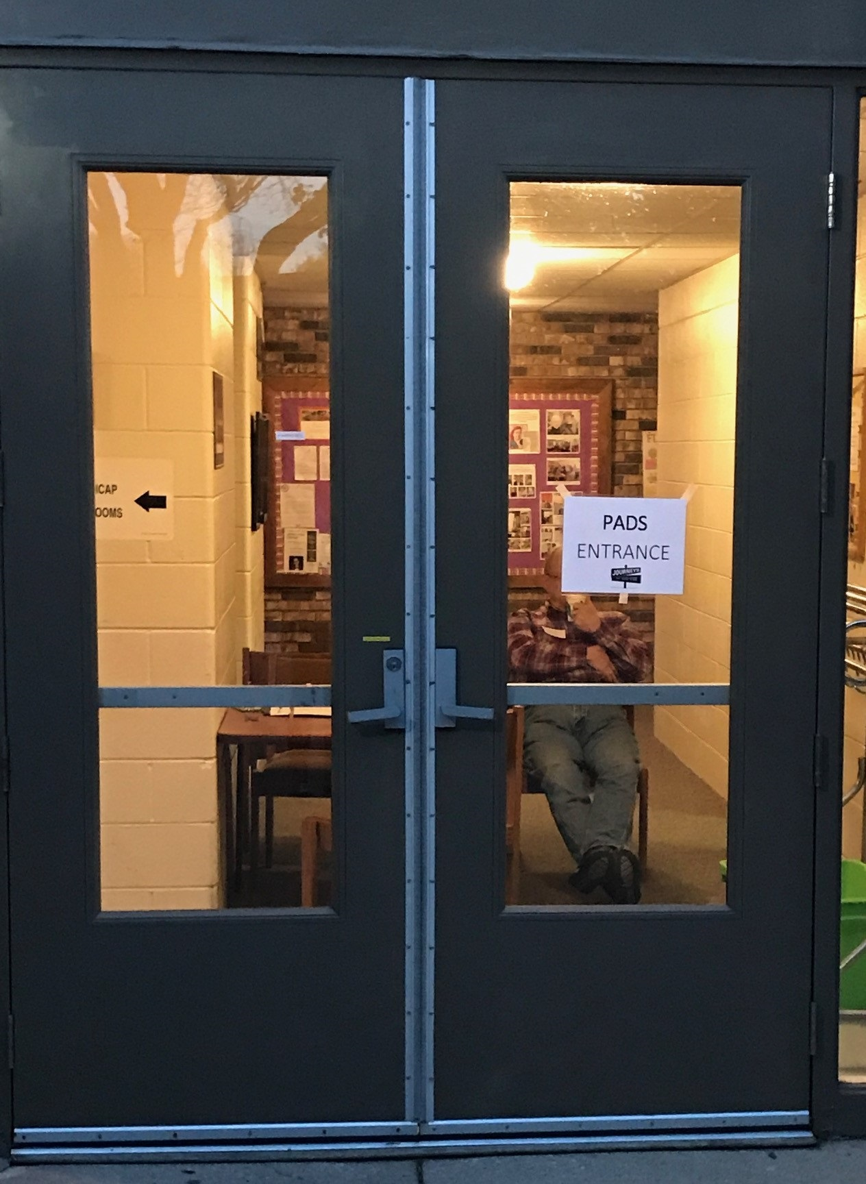
PADS October 1st – April 30th
Initial step:
1989 Northwest Suburban PADS, Inc.
Current Program:
12 faith-based sites
Over 2,500 volunteers
Average of 25 guests per night.
7pm to 7am for PADS Guests
Notes:
In 1989, Northwest Suburban PADS, Inc. was created to provide shelter and meals to the homeless in our community. The October – April PADS program currently has 22 faith-based sites that provide overnight shelter, a warm dinner, breakfast and a sack lunch. The program is staffed by over 2,500 volunteers, and during the last year housed an average of 74 guests per night. The PADS sites are open every night from October 1 – April 30, 7:00 p.m. to 7:00 a.m.

Slide 18
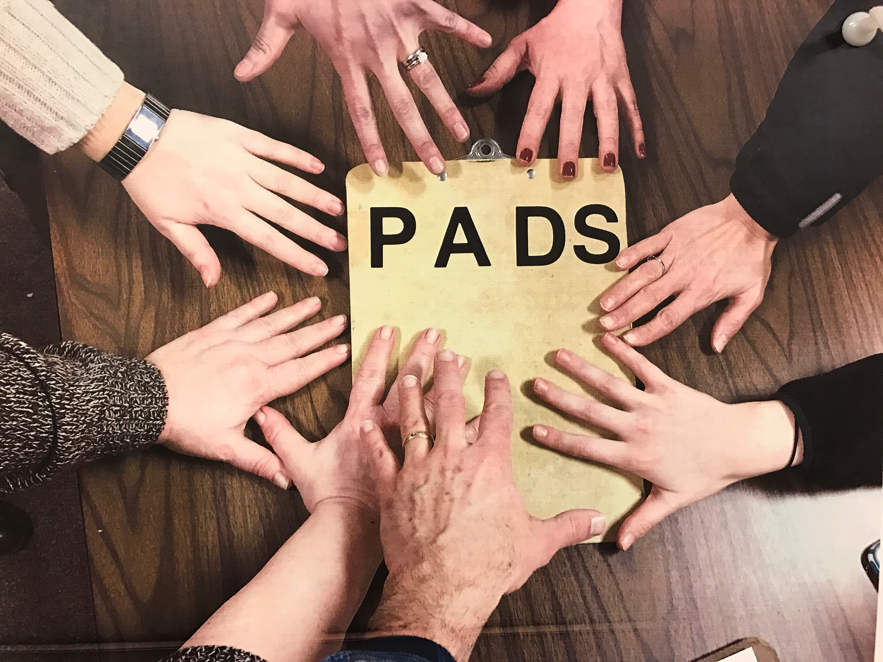
Become a PADS Volunteer!
Sites rely solely on volunteers
Shift responsibilities vary
Sites available year-round!
Up to 12 sites, October 2023 – April 2024
2024, May – September to be determined

Slide 19
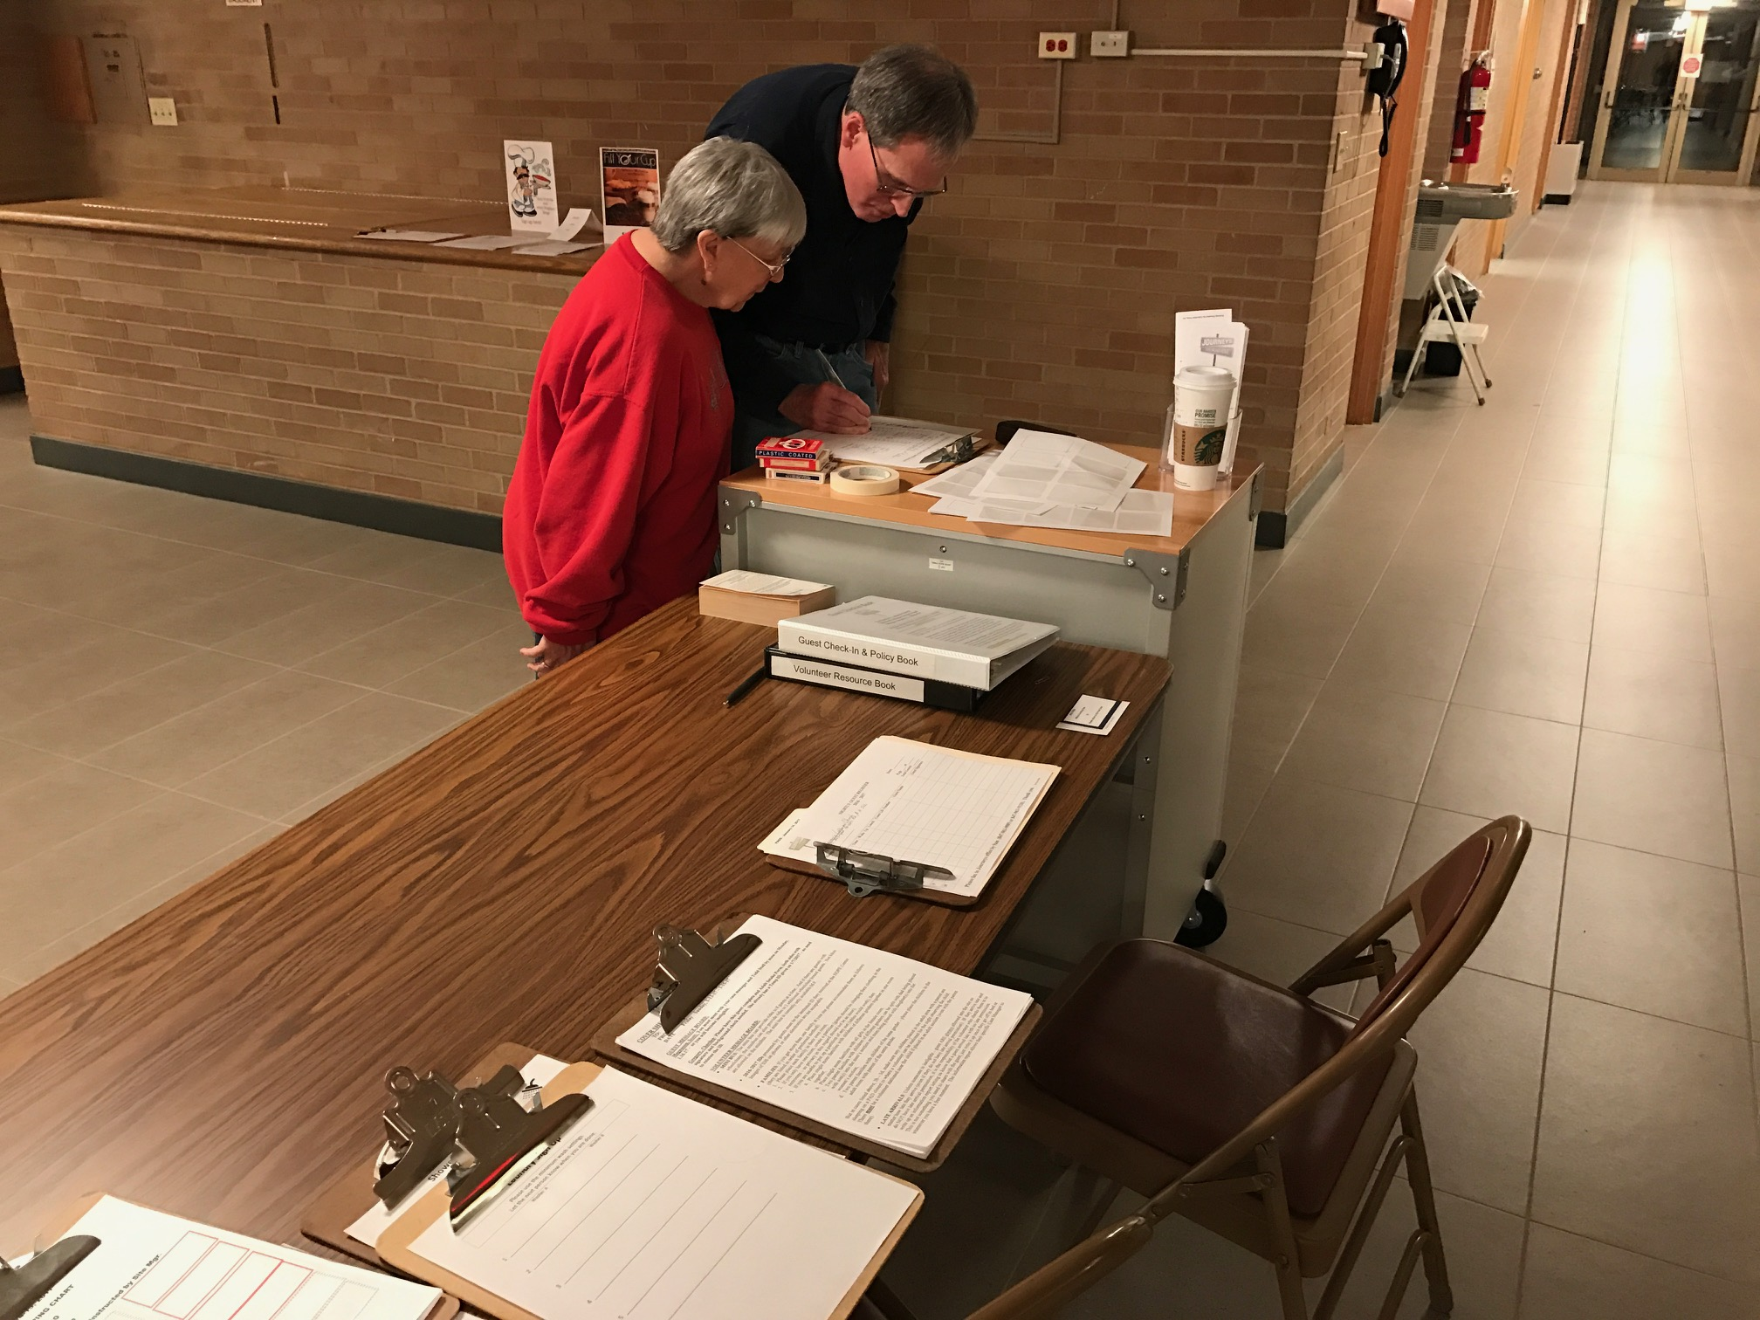
Become a PADS Volunteer!
SETUP SHIFT (Begins 6:00 PM (Varies))
Ready sleeping area
Receive food and set up dining area
Set up registration desk
Monitor parking lots
Youth volunteers under 7th grade may help with this shift.
FIRST SHIFT (6:30 PM - 11:00 PM (Varies))
Provide a portion of the meal
Register clients
Assist with serving dinner
Make clients feel welcome
Monitor all areas & secure doors
Notes:
Shift times will vary from site to site depending on the site’s capacity.

Slide 20
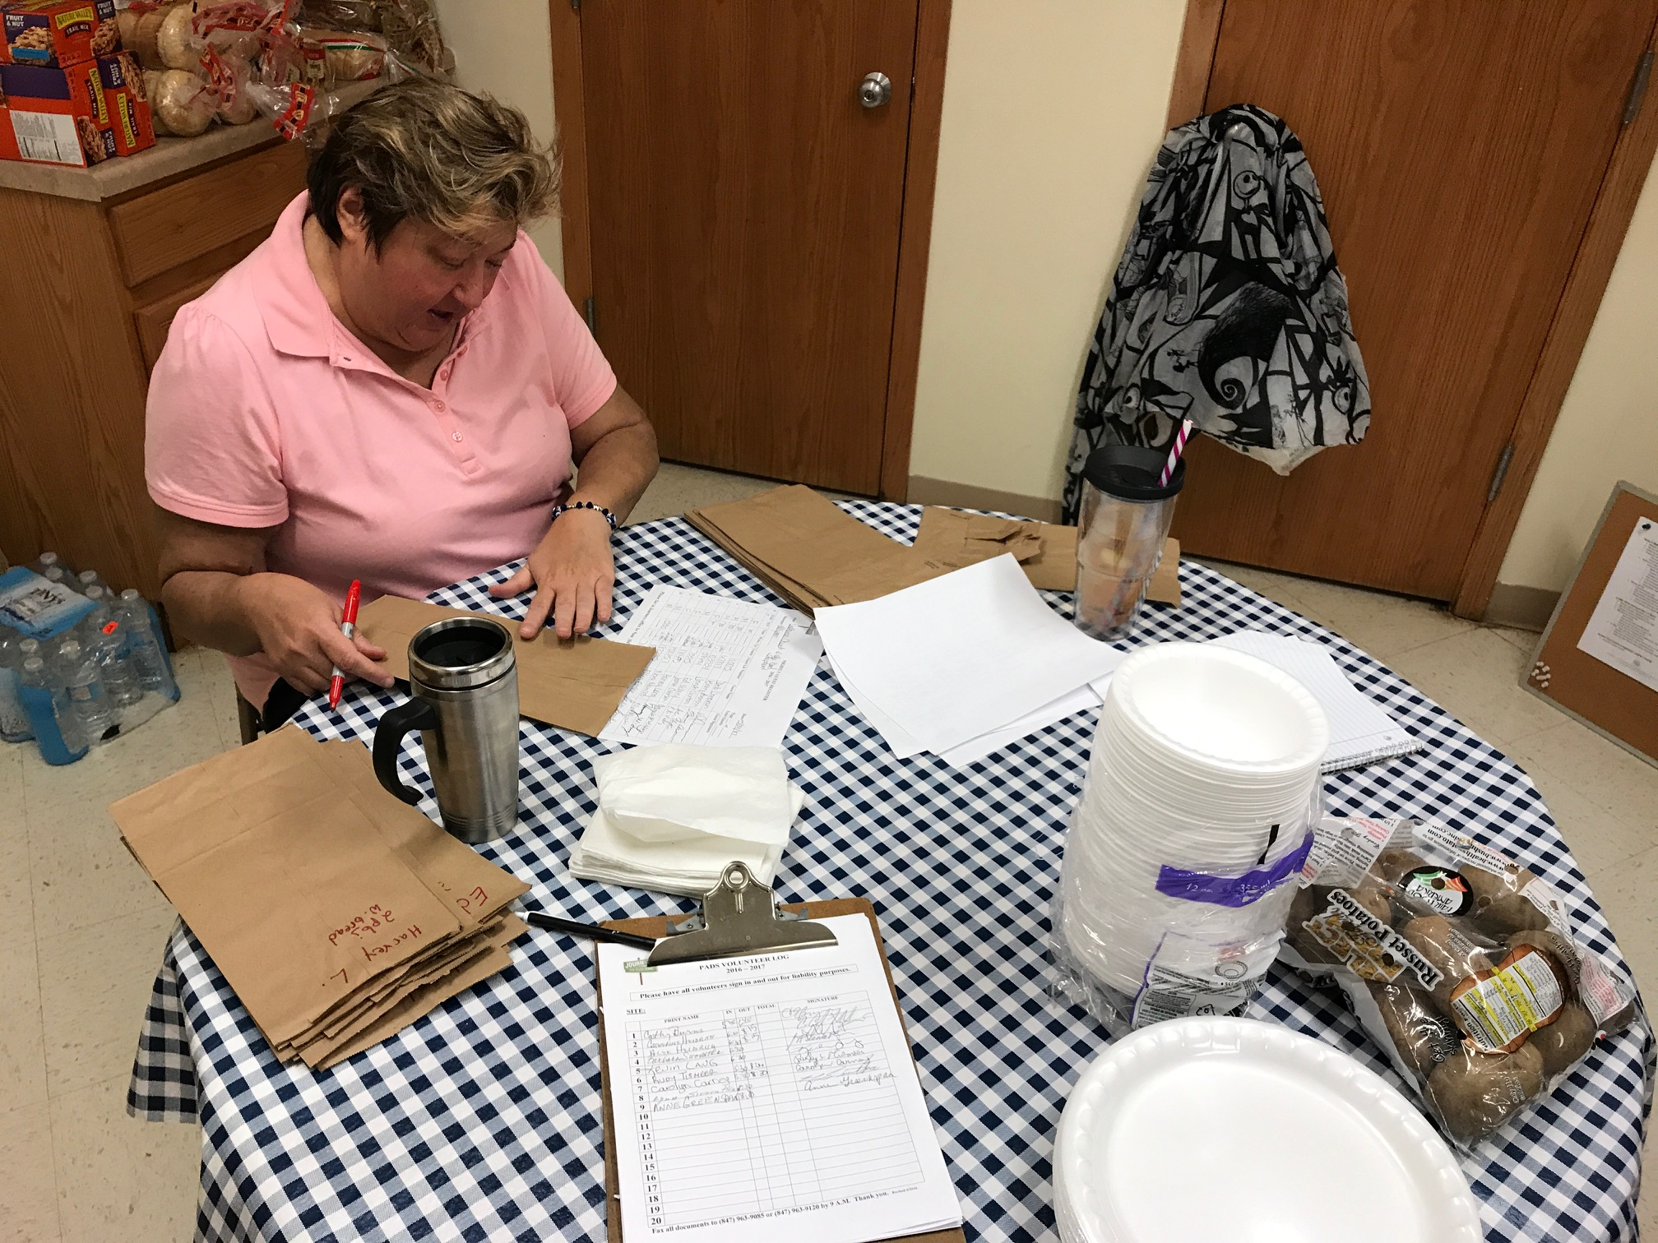
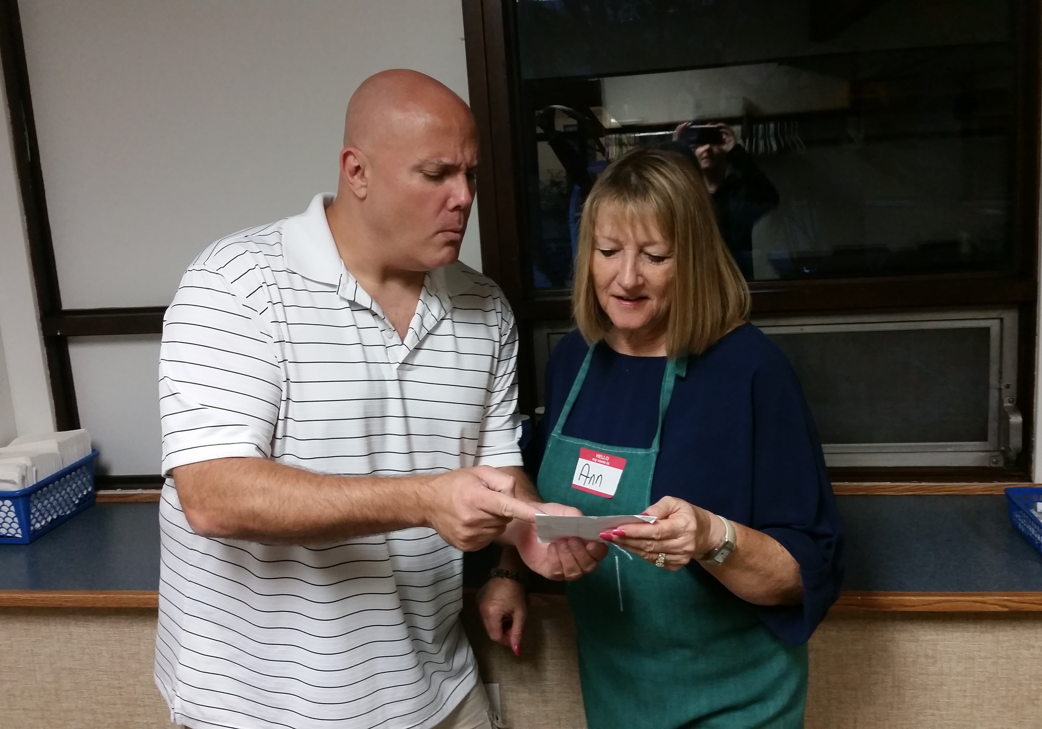
Become a PADS Volunteer! Volunteers are urgently needed for the SECOND and THIRD shifts. At least one man and one woman is required for each shift.
SECOND SHIFT (11:00 PM - 3:00 AM (Varies))
Maintain intake desk
Admit approved late arrivals
Prepare lunches
Monitor all site areas hourly
Awaken clients early if needed
THIRD SHIFT (3:00 AM - 7:00 AM (Varies))
Maintain intake desk
Admit approved late arrivals
Awaken clients
Prepare and serve breakfast
Notes:
Shift times will vary from site to site depending on the site’s capacity.

Slide 21
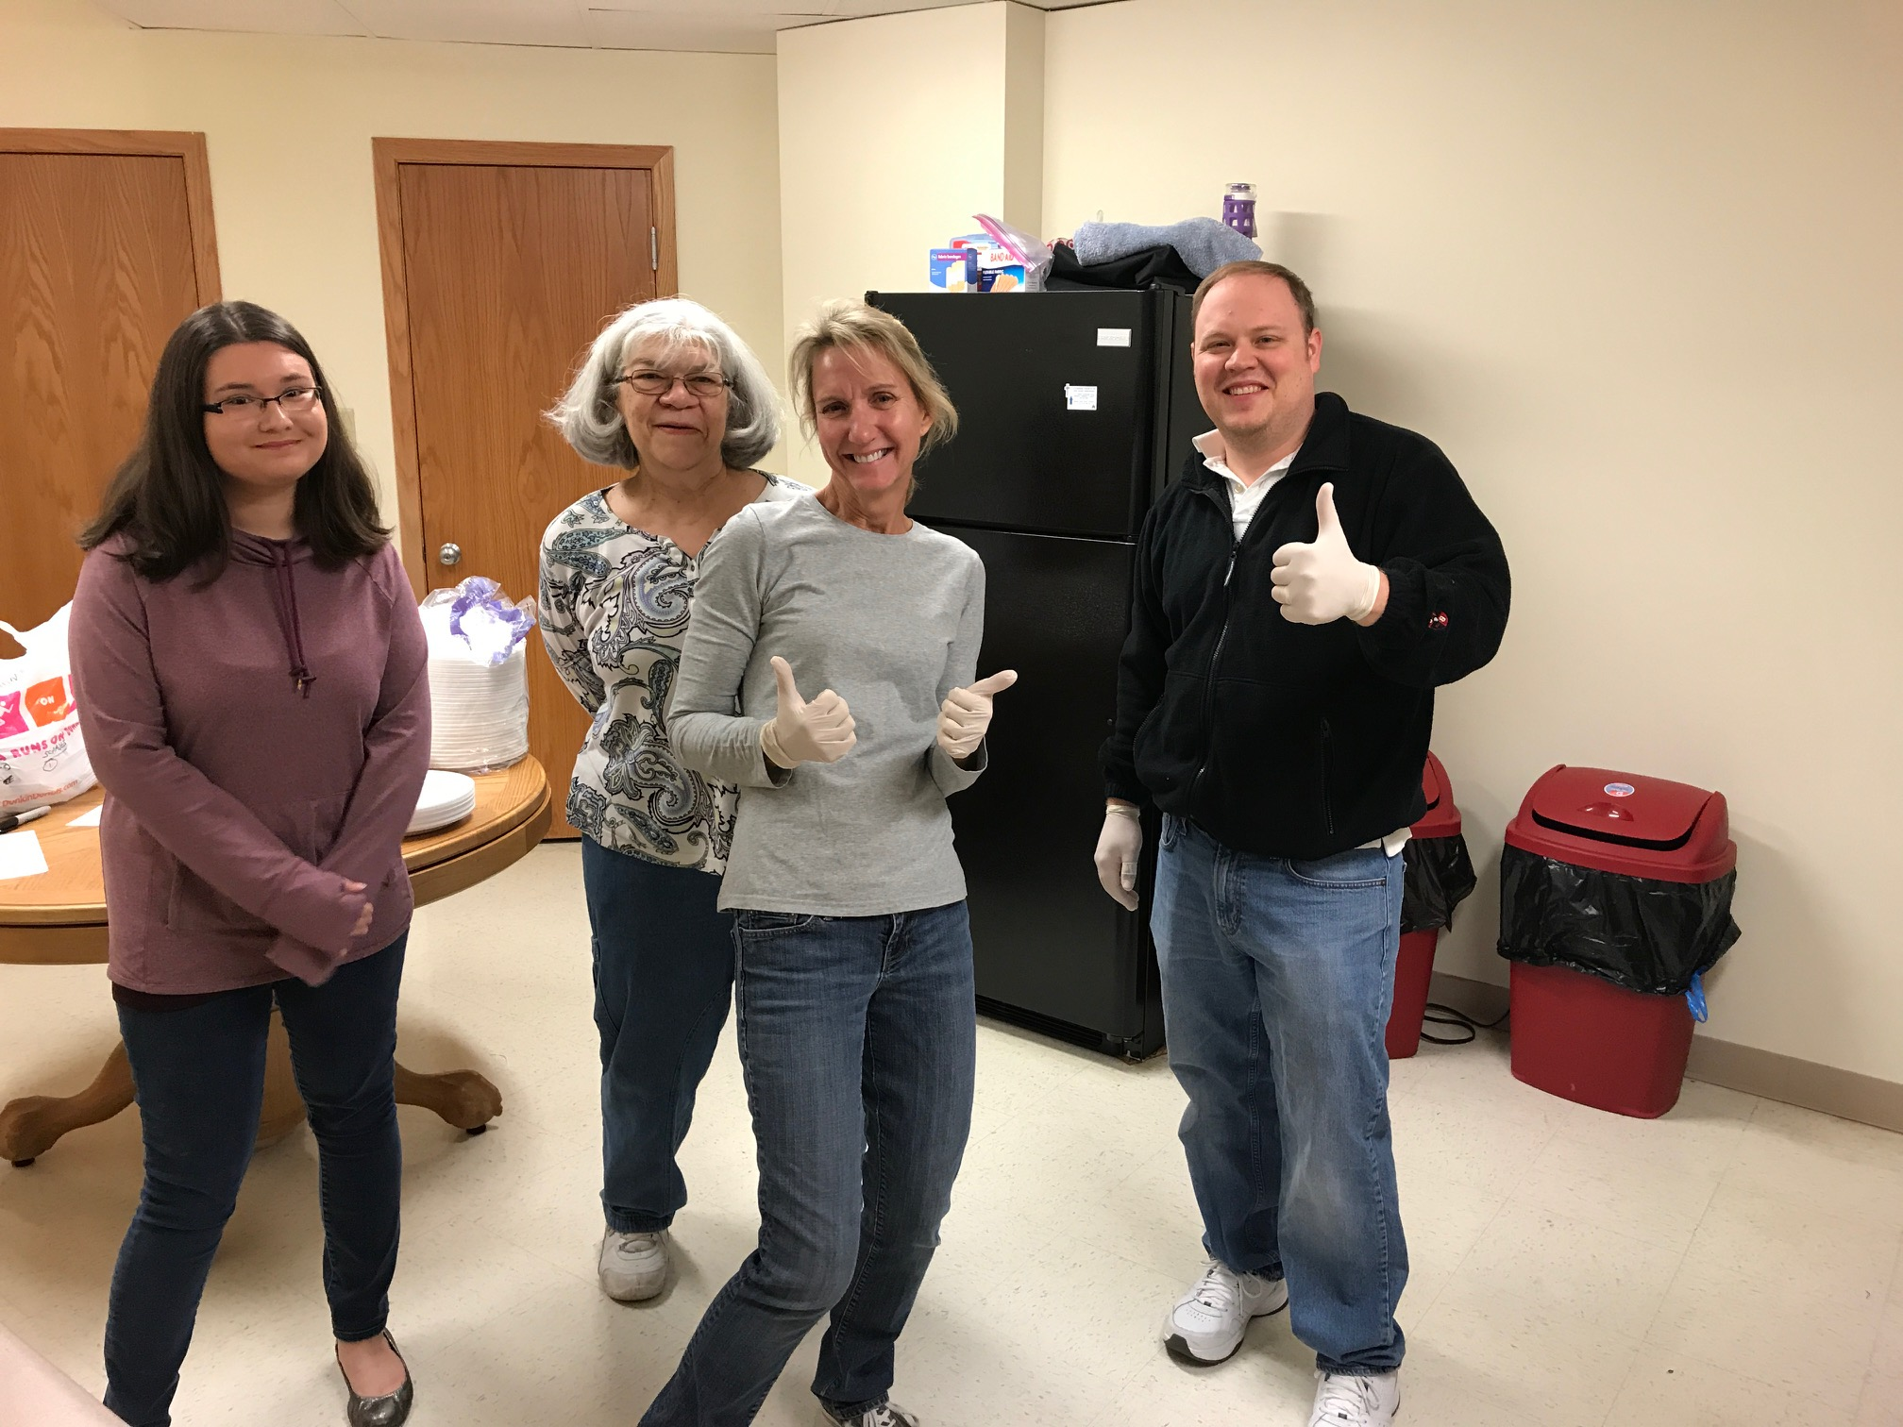
Become a PADS Volunteer!
CLEANUP SHIFT
(6:00 AM - 7:00 AM (Varies))
Wipe down/put away mattresses, pillows, tables, and chairs
Mop or vacuum floors
Clean restrooms
Empty trashcans
Put away toiletries and clothing
Clients may assist and receive gift certificates for their help
Youth volunteers under 7th grade may help with this shift.

Slide 22
PADS site Locations October 2023- April 2024- These sites are kept private from public to prevent people sending unvetted people to sites
Sunday
Holy Family Catholic Community – Inverness
Christus Victor – Elk Grove Village
Monday
St. Mark’s Lutheran Church – Mt. Prospect
Our Savior Lutheran – Arlington Heights
Tuesday
Kingswood United Methodist Church – Buffalo Grove
First Presbyterian Church – Arlington Heights
Wednesday
St. James Catholic Church- Arlington Heights
St. John UCC- Arlington Heights
Thursday
Hope Community - Glenview
1st United Methodist of AH (FUMCAH) – Arlington Heights
Friday
St. John UCC- Arlington Heights
Saturday
All Saints Lutheran Church – Palatine
St. Alphonsus Catholic Church – Prospect Heights
Notes:
Each night from October - April PADS has 2 or 3 sites open in our service area. Most of the sites are centrally located and we do transport clients to and from the sites with our minibus.

Slide 23
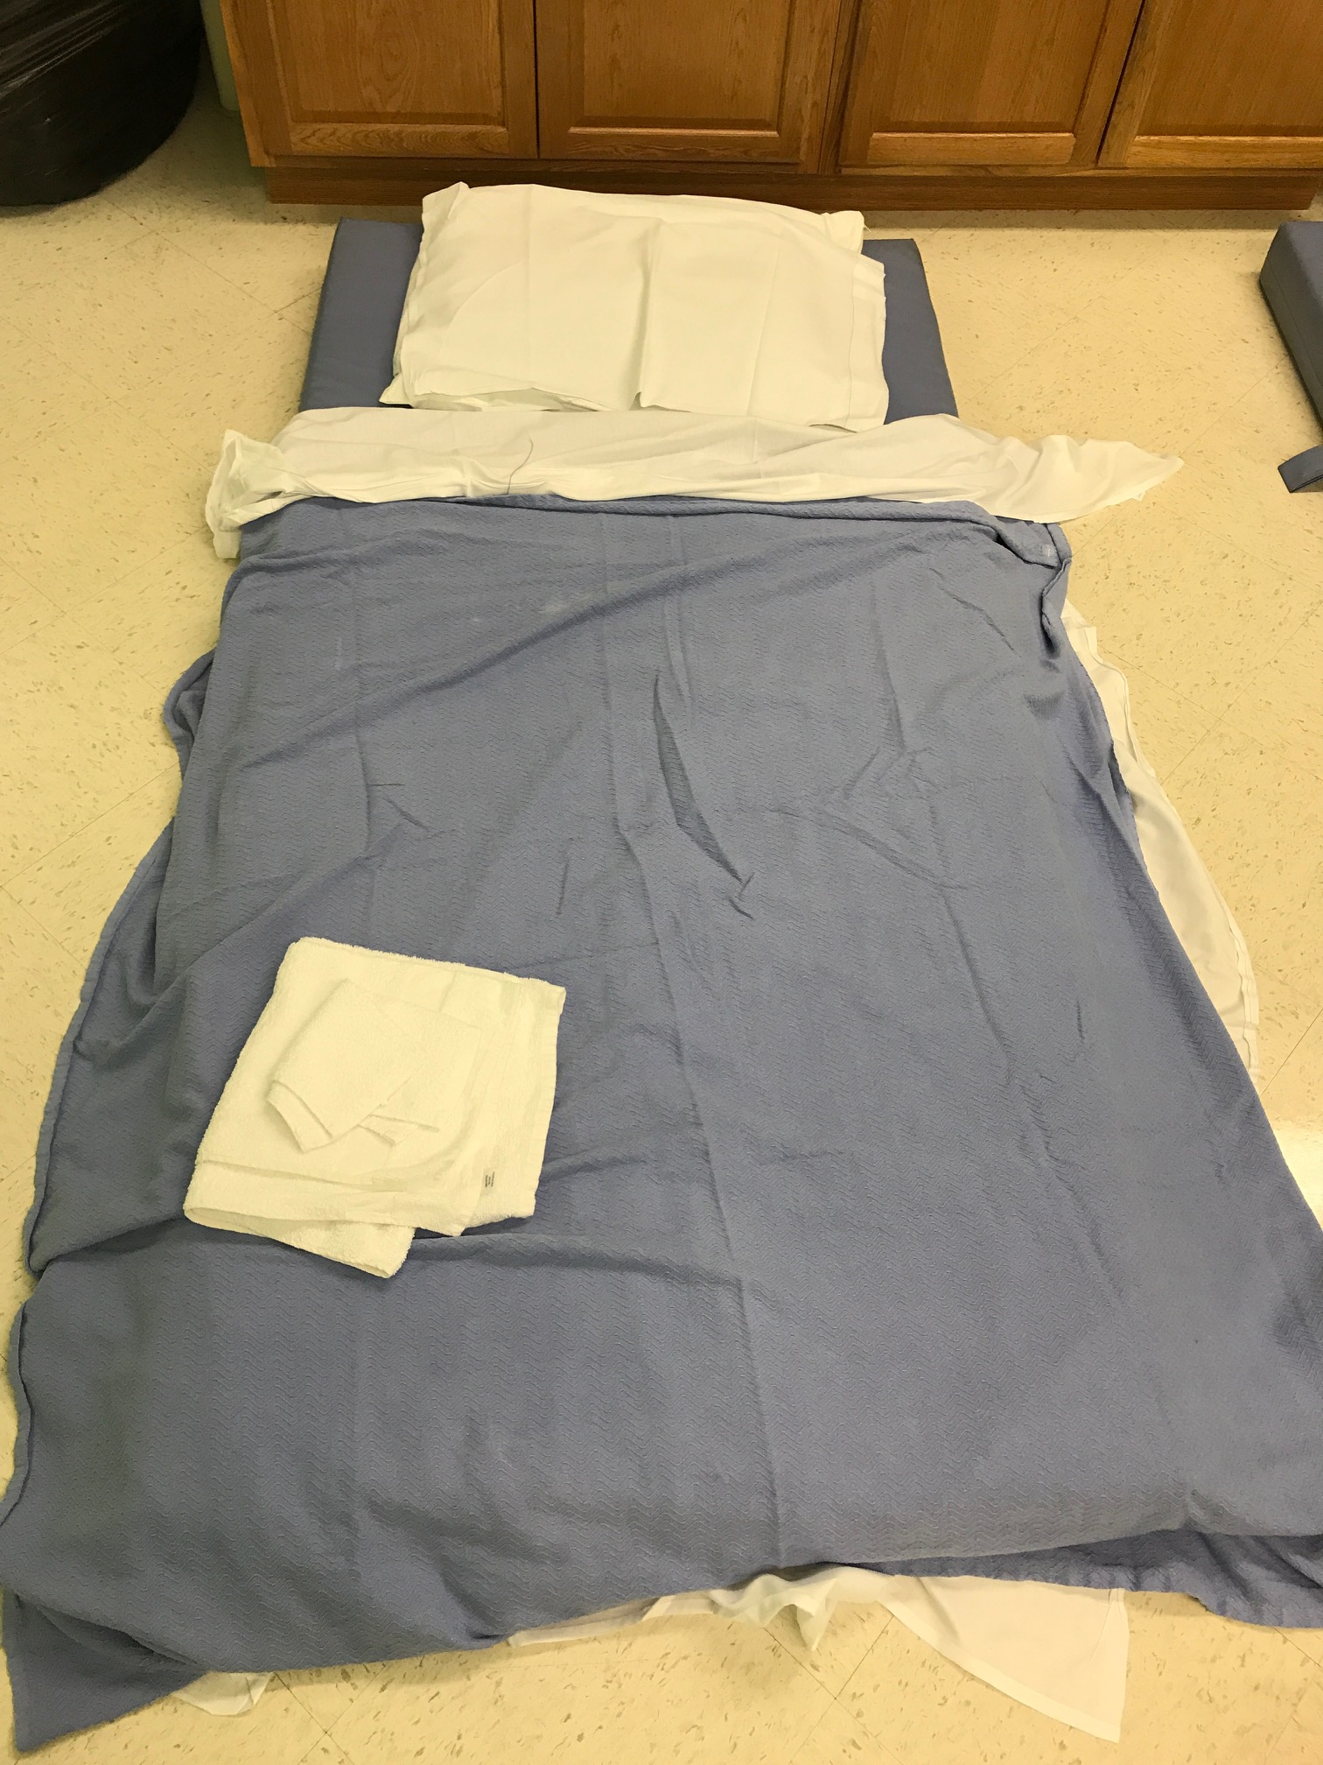
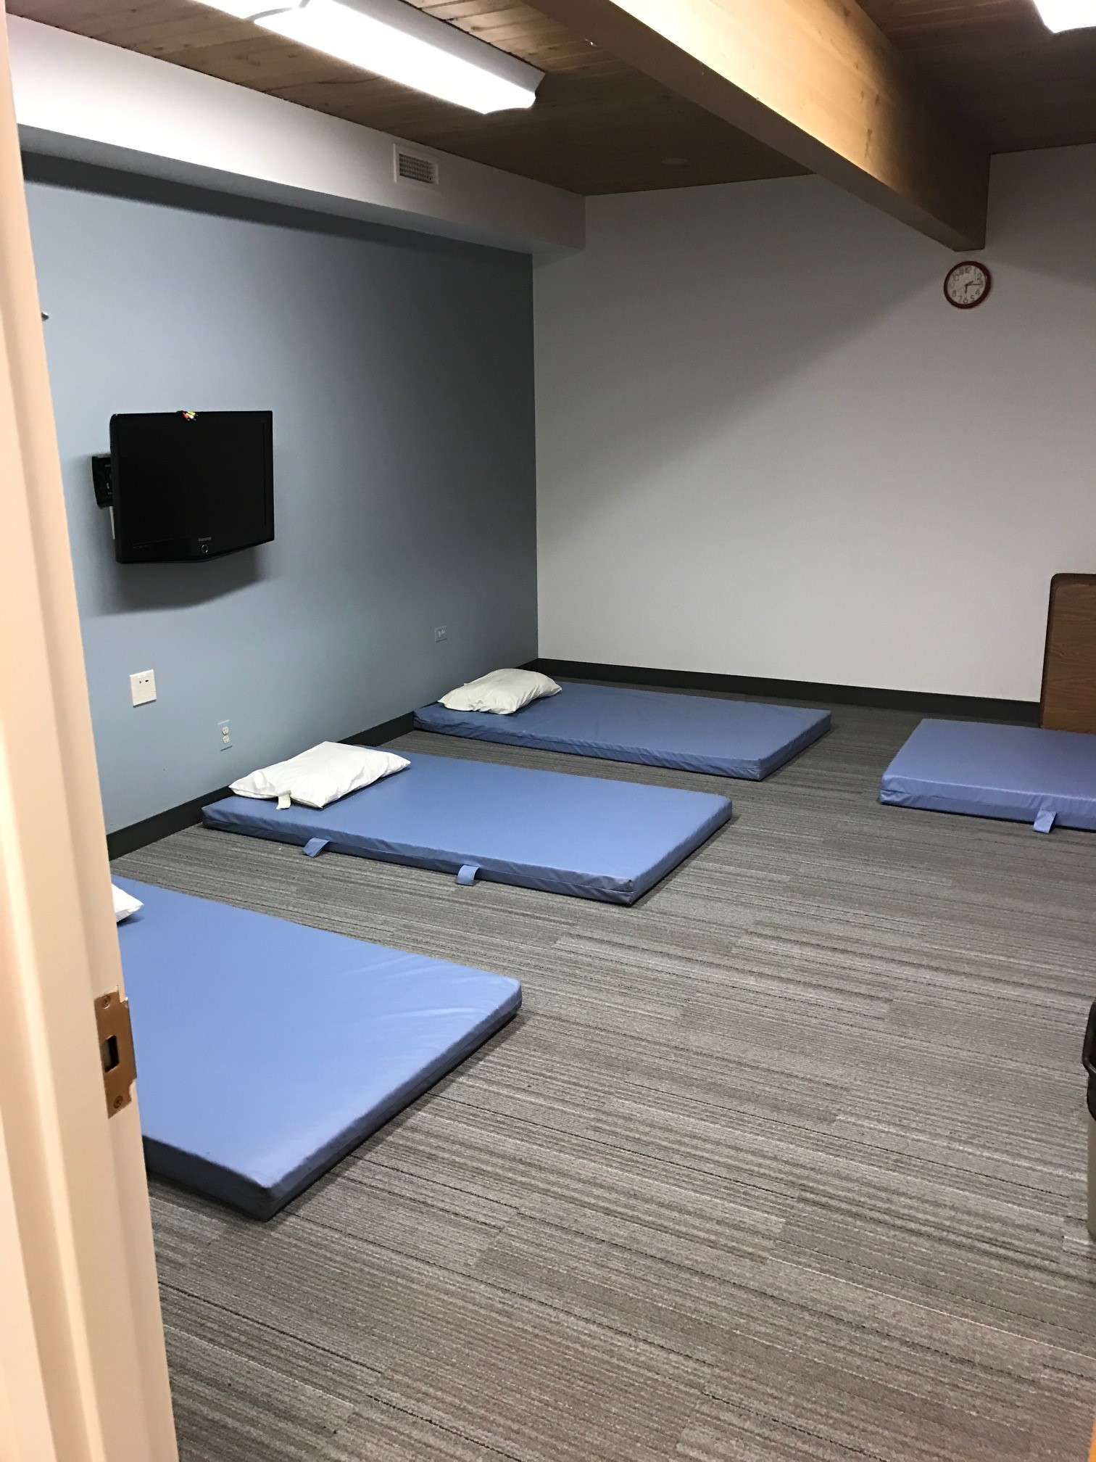
Critical Importance of the PADS program
First contact with people who care
Safe overnight shelter
Warm meals
Mission driven and grass roots
Equal importance to HOPE Center and long-term housing, Pathways Housing Readiness Program.
Notes:
Most of the time PADS is the first contact that our clients have with JOURNEYS. This may be the first time they have had shelter, a warm meal, or a safe place to sleep in days, weeks, or months. PADS is also critically important because it is grassroots and mission driven. The volunteers involved with PADS are dedicated to helping their guests. PADS is equally important to both the HOPE Center and the Pathways Housing Readiness program. The overnight shelter program provides a safe place to sleep for guests while they work with their Case Managers at the HOPE Center towards stable housing.

Slide 24
PADS overnight shelter ineligibility
Unsafe
Person convicted of a violent felony or multiple misdemeanors
Acting aggressively
Has a contagious disease
Last known address outside the JOURNEYS service area
All ineligible clients are referred to more appropriate agencies
Notes:
-A person convicted of a violent felony or multiple misdemeanors, acting aggressively, infected with a contagious disease or an individual who does not respect the code of conduct may become ineligible.
-If a person’s last address was outside of the JOURNEYS service area, they may become ineligible.
-All ineligible clients are referred to more appropriate agencies.

Slide 25
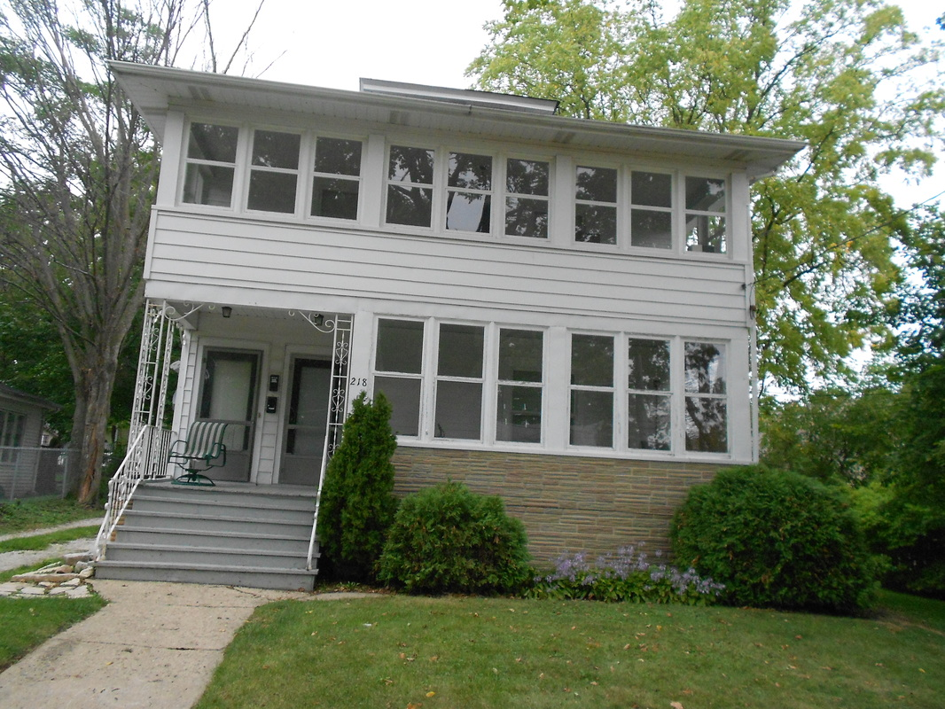
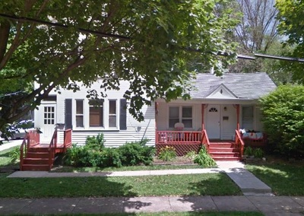
Pathways Housing Readiness Program Supportive Housing
2007 PDI, Pathway Development Institute
PDI – Real Estate Holding Company
Affordable Housing
Transition clients to independent housing
Roommate/Landlord negotiations
Cooking, cleaning, etc.
Up to 15 clients
Notes:
This program prepares clients to re-enter mainstream permanent housing.
Final Step: 2007 JOURNEYS partnered with Pathways Development Institute (PDI).
PDI is a real estate holding company. Its sole mission is to purchase buildings in our service area and provide affordable housing exclusively to JOURNEYS’ clients.
These 2 buildings can serve about 15 clients at one time.
JOURNEYS helps these clients transition to mainstream housing by teaching life skills like roommate negotiation, cooking and cleaning, and landlord interaction.

Slide 26
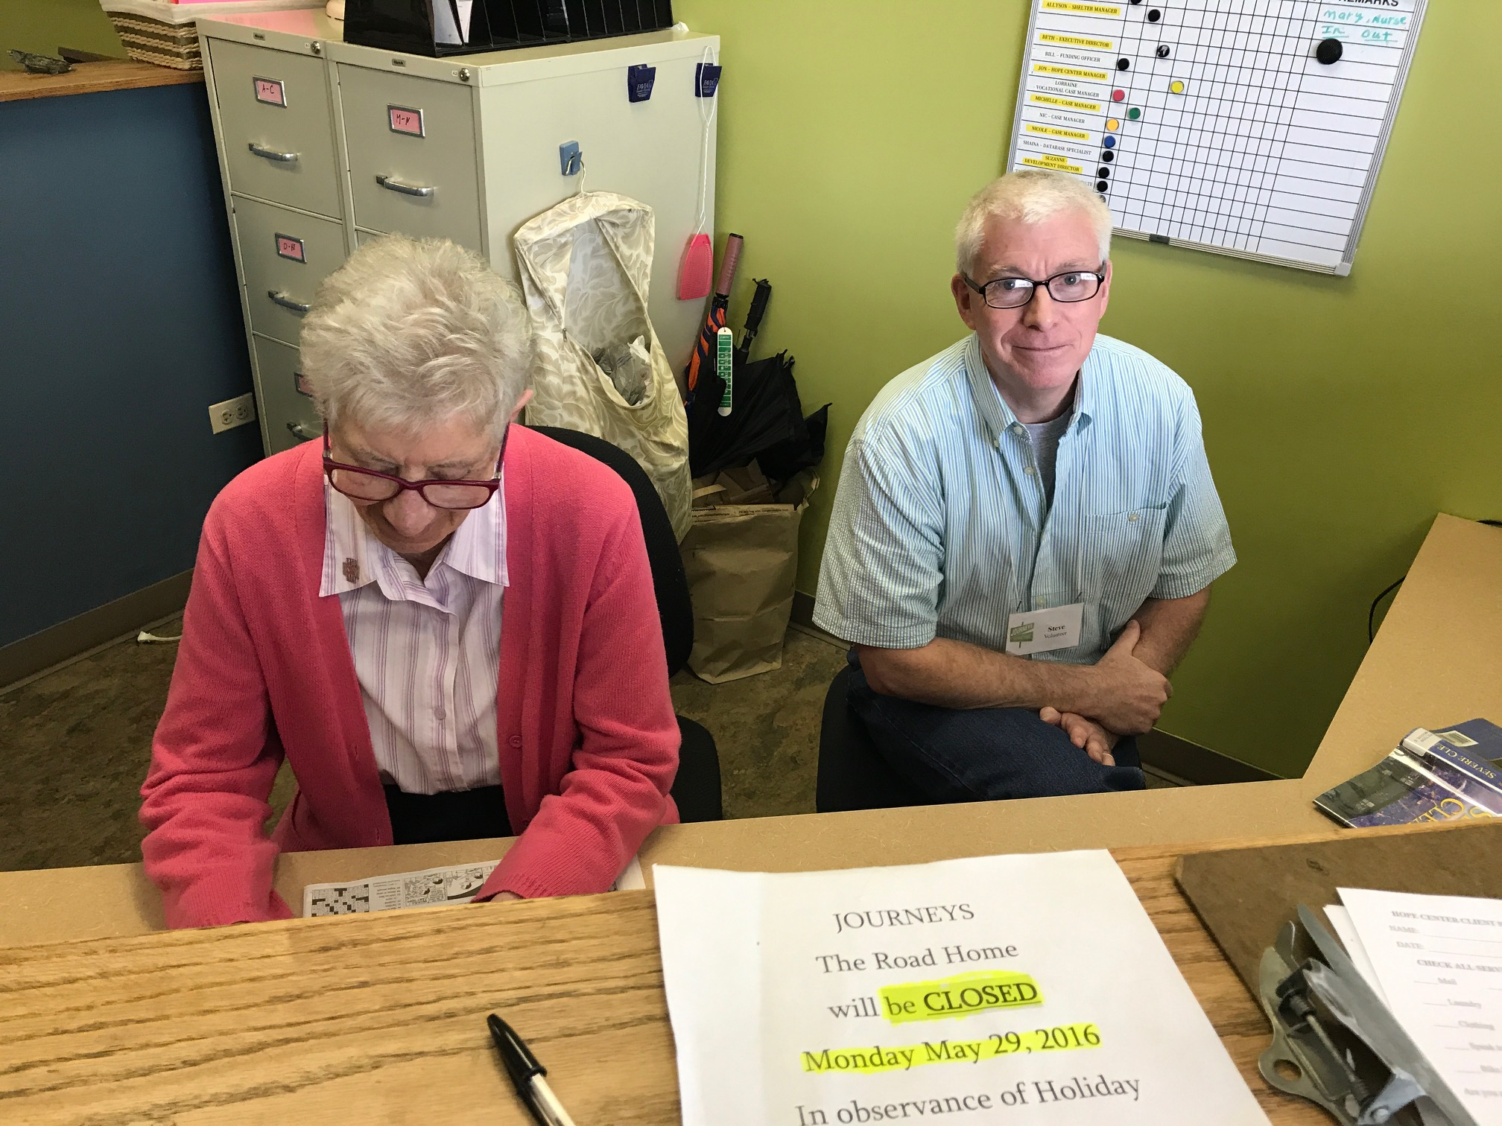
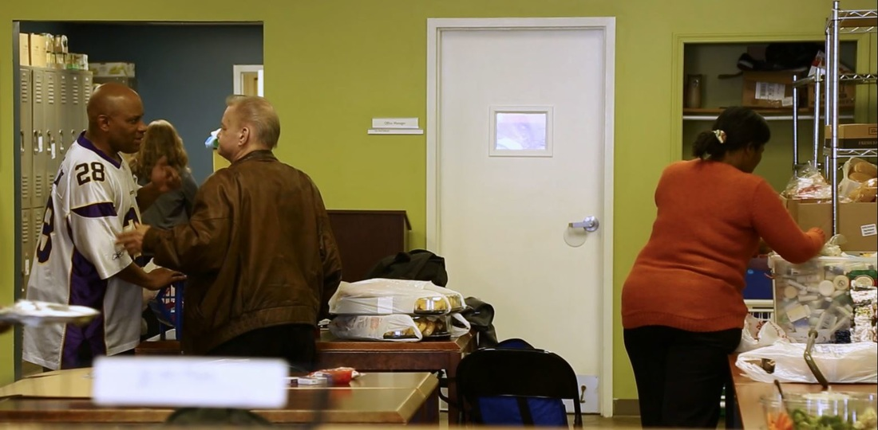
How does someone become a client?
Government issued photo ID
Proof of current or last known address
Background check

Slide 27
How do we pay for free client services? JOURNEYS is a 501(c)(3) Not-for-Profit Agency. Our funding comes from a number of sources

Slide 28
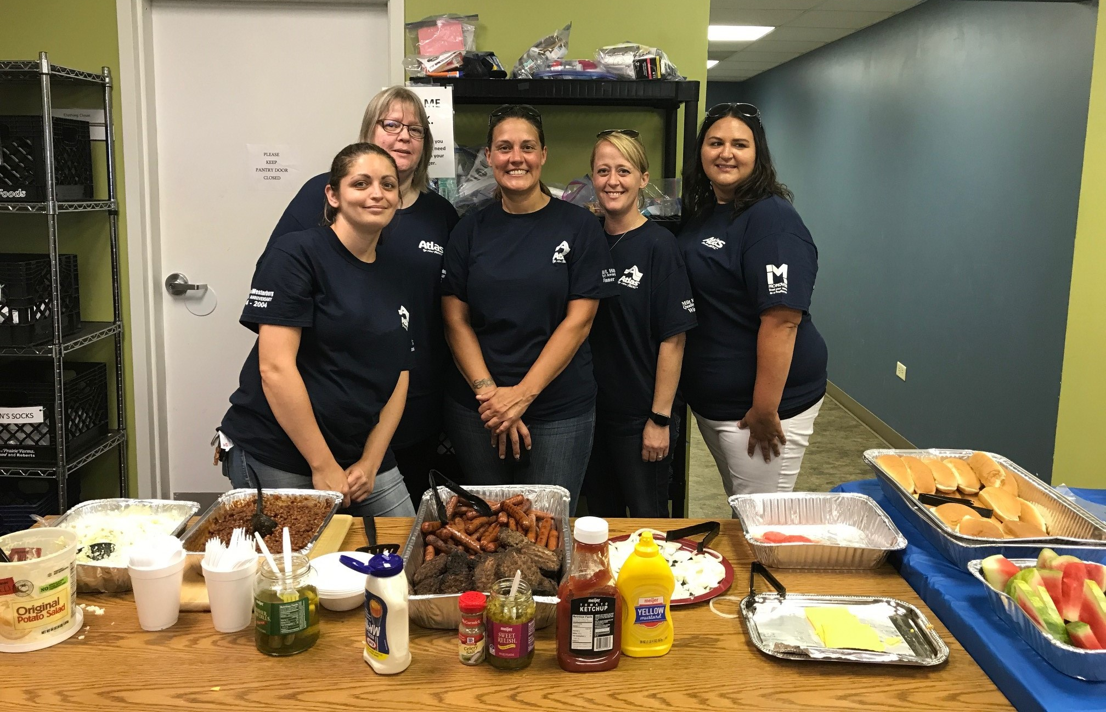
Ways to Get Involved
Volunteer/Donate
Host a Collection or Drive
Be a Corporate Ambassador
Attend an Event

Slide 29
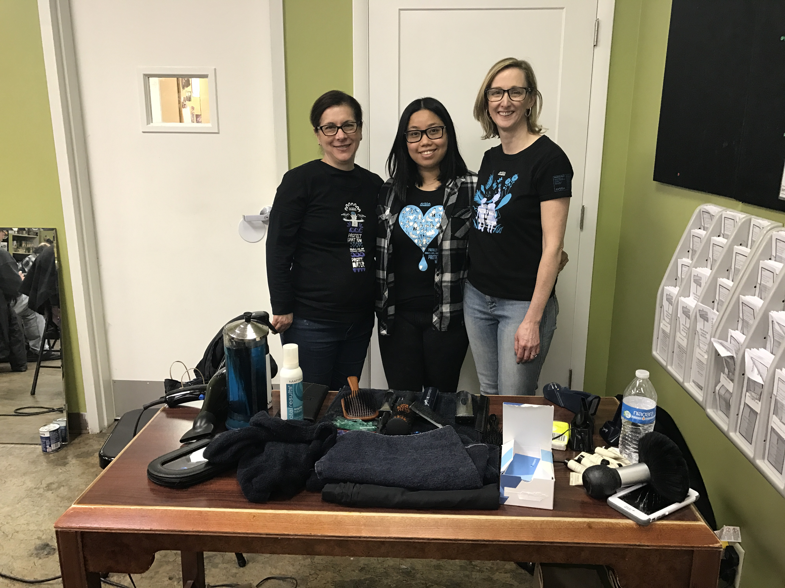
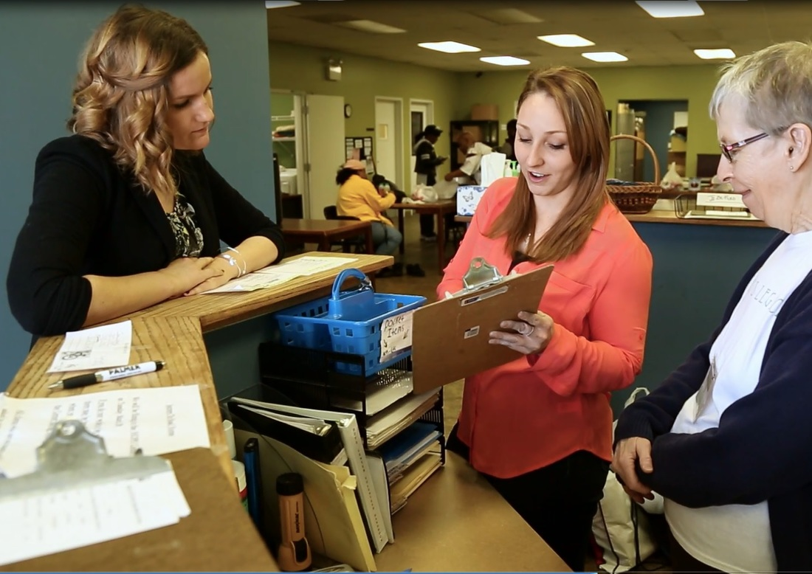
What is the role of a volunteer?
Show respect for all clients, volunteers and staff
Smile and listen to the clients
Complete assigned tasks as outlined by volunteer supervisor
Maintain safe and strong boundaries

Slide 30
Maintain Safe and Strong Boundaries
Most clients will not violate policies
A tiny minority of clients will engage in unsafe behavior
Do not give cash to clients, because that shows favoritism
Being alone in a vehicle with a client can lead to dangerous situations
An alternative would be to call a cab or the JOURNEYS minibus, if available, for client rides.
Do not disclose your address, workplace, school, or other personal information
Occasionally clients have sought out volunteers outside of the shelter

Slide 31
Maintain Safe and Strong Boundaries
Do not have any close physical contact with clients
Handshakes are OK, but hugs, massages or kisses are not permitted because they can be misinterpreted.
Only the Site Director can approve storage of refrigerated medications
If you have a job lead for a client, contact the Vocational Case Manager to appropriately connect the client
If you directly give a job to a client, you are creating favoritism
Do not allow a client to use your cell phone
It is possible a client would then call you after the site closes, putting you in a difficult situation

Slide 32
Confidentiality
All client information MUST remain confidential!
Notes:
All client information MUST remain confidential. It is essential that our clients know that we take their privacy very seriously. At JOURNEYS we abide by the confidentiality guidelines set forth in the Health Information Portability and Privacy act, or HIPPA. Under no circumstances are we to reveal any identifying information about our clients to anyone outside the agency. For example, if a person calls looking for a client, we reply with “we can neither confirm nor deny that the person is a client with this agency.” It does not matter whether someone claims to be a relative or know the client. You do not know the situation or whether the client even wants to be found by the individual calling.

Slide 33
Phone Policy
Never take pictures of clients
That violates confidentiality
Pictures of the shelters can only be approved by Site Directors or staff
Personal Social Media posts
Tag only JOURNEYS | The Road Home
Do not tag the specific location you volunteer at
(i.e. the HOPE Center, a PADS site, etc.)
Notes:
With confidentiality comes the need for a no client picture policy. We also discourage posting on your personal social media accounts without permission from the Volunteer Coordinator. If you would like to share your experience, please tag JOURNEYS | The Road Home or send pictures taken before or after your shift with a blurb to the Volunteer Coordinator. It is highly encouraged to talk to the Volunteer Coordinator before using your personal social media accounts to maintain client confidentiality. Youth should never specify where they volunteer.

Slide 34
Dress Code
Masks are optional
Jeans are acceptable, but cannot be ripped
Skirts and short must not hit above the knee
No tank tops/shirts that expose any part of the abdomen
No clothing with school symbols or indication of clubs/activities
Closed toes shoes in the Kitchen
Notes:
Dressing casually provides a comfortable setting for volunteers and people without housing.

Slide 35
Unsure of What to Do?
If you find yourself in a situation that you are unsure of, go directly to the Site Director at PADS, or the Volunteer Coordinator at the HOPE Center.

Slide 36
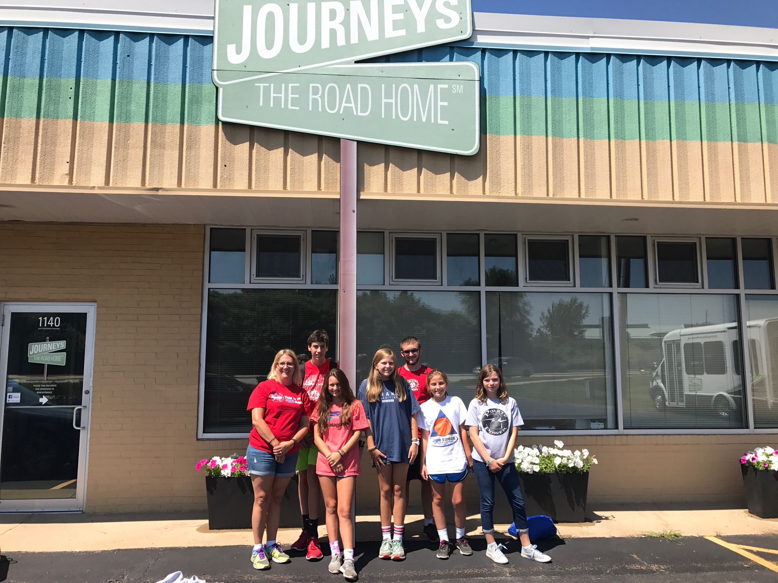
Youth Volunteer Opportunities
Below 7th grade may volunteer when clients/guests are not present
7th – 9th may volunteer when guests are present with a parent or guardian
10th – 12th may volunteer when guests are present but must work side by side with an adult volunteer
Additional form must be filled out for all youth volunteers.
Notes:
JOURNEYS welcomes youth volunteers to participate in the various programs mentioned before. There are policies in place to keep youth safe. Youth under 7th grade may not volunteer when a client is present. Youth between 7th – 12th grade may volunteer when clients are present, but with limitations. 7th – 9th grade must have an adult parent or guardian present at all times during volunteer shift. 10th – 12th grade may volunteer without a parent or guardian, but will be assigned a task working side by side with an adult volunteer. Youth volunteer opportunities vary among PADS sites, so please see me or the Volunteer Coordinator before leaving. Youth must also be aware that a shift may be cancelled if a youth client is anticipated to stay at a site.

Slide 37
COVID – 19 Policy at PADS Highlights
JOURNEYS RECOMMENDS STRONGLY, but does not require at this time, volunteers taking part in the PADS program be vaccinated to current CDC guidelines and be willing to offer proof of vaccination to Site Director(s) if requested.
Tests should only be administered to clients/guests displaying COVID symptoms during the check-in process. Clients with a positive test should be told that they cannot stay and should be offered emergency medical services if they are interested.
Sleeping pads are to be placed 18 to 24 inches apart with clients sleeping alternating head-to-toe whenever possible
Please avoid a “buffet style” meal service and rather serve one by one

Slide 38
COVID-19 Policies and Procedures
Delivery Volunteers
Food packaging needs to stay closed and intact. It should only be opened by the person it is being delivered to.
Gloves must be worn at ALL times.
Reduce the surfaces that you touch with your hands. (door handles, light switches, etc.)
Single use items should be disposed of after one use.
COVID policies are subject to change as CDC requirements change, and will be relayed to PADS sites by Shelter and Housing Manager

Slide 39
COVID-19 Policies and Procedures
CDC Guidelines
Avoid close contact with people who are sick.
Avoid touching your eyes, nose, and mouth.
Stay home when you are sick.
Cover your cough or sneeze with a tissue, then throw the tissue in the trash.
Wash your hands often with soap and water for at least 20 seconds, especially after going to the bathroom; before eating; and after blowing your nose, coughing, or sneezing. If soap and water are not readily available, use an alcohol-based hand sanitizer with at least 60% alcohol. Always wash hands with soap and water if hands are visibly dirty.
Volunteers commit to NOT show up to volunteer if they feel any symptoms of a new illness. Volunteers also commit to notify the Volunteer Coordinator of any suspected or confirmed coronavirus diagnoses in themselves or their close contacts, to assist the agency in coordinating contract tracing and medical care for vulnerable individuals.

Slide 40
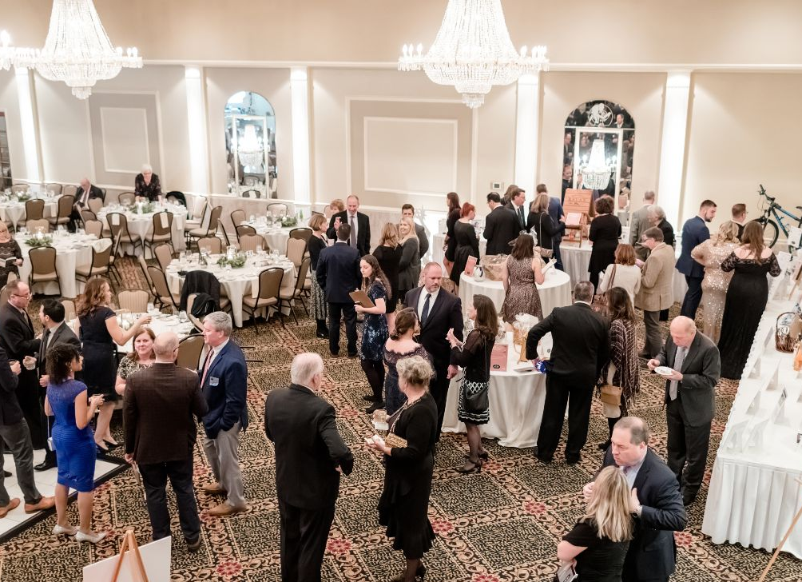
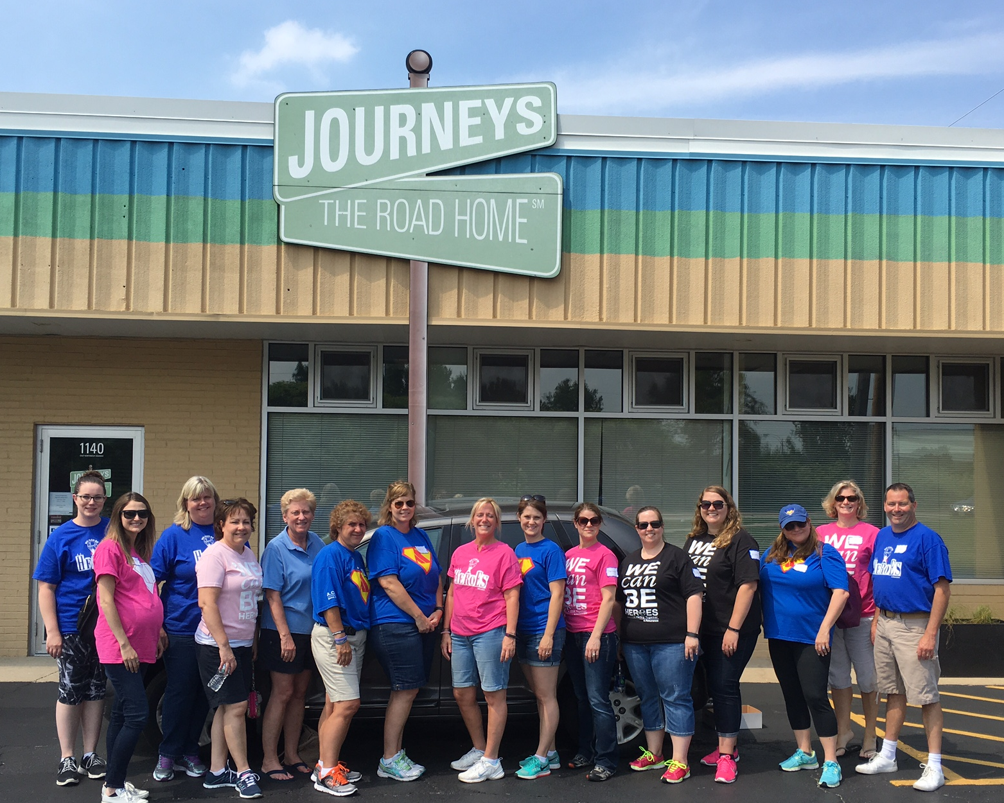
Special Events & Group Volunteering
3 Annual Events:
BID for HOPE (November)
Women’s Luncheon (April)
Superhero 5K (June)
Group Volunteering
Organize a room in the building
Landscaping in the Spring
Other projects as needed
Notes:
Different activities are available based on the season and must be scheduled with the volunteer coordinator.

Slide 41
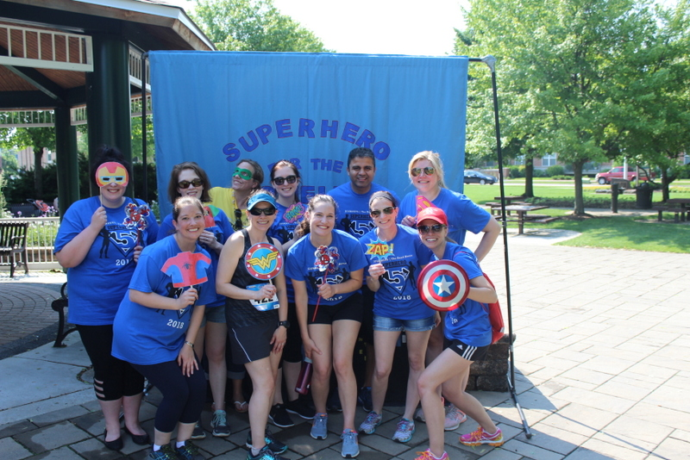
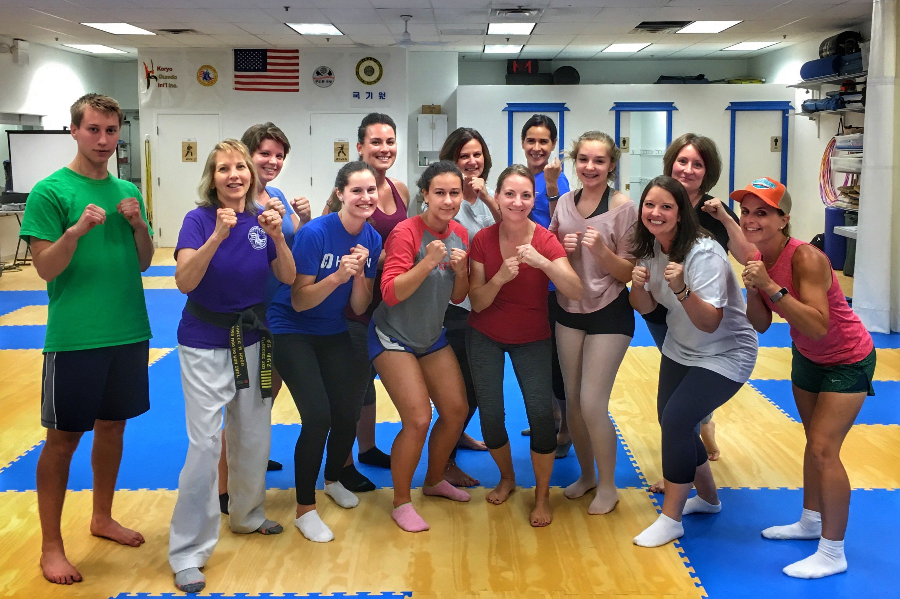
Young Professionals Board
21-39-year-olds interested in philanthropy and volunteerism—all backgrounds encouraged to join!
Focus on outreach and events to support JOURNEYS mission
Ex: Dine & Shares, Superhero 5K, Self-Defense Seminar
Members must raise or give $200 annually
Meetings are the monthly and a social every quarter
Notes:
The Young Professionals Board (YPB) is a diverse group of 15 with a President, Vice President, and Secretary from all backgrounds including Information Technology, engineering, marketing, healthcare, and more!
It has 2 committees: marketing and outreach, and events.
YPB’s official agency event is the Superhero 5K. They also plan smaller events throughout the year like dine and shares and a self-defense seminar.

Slide 42
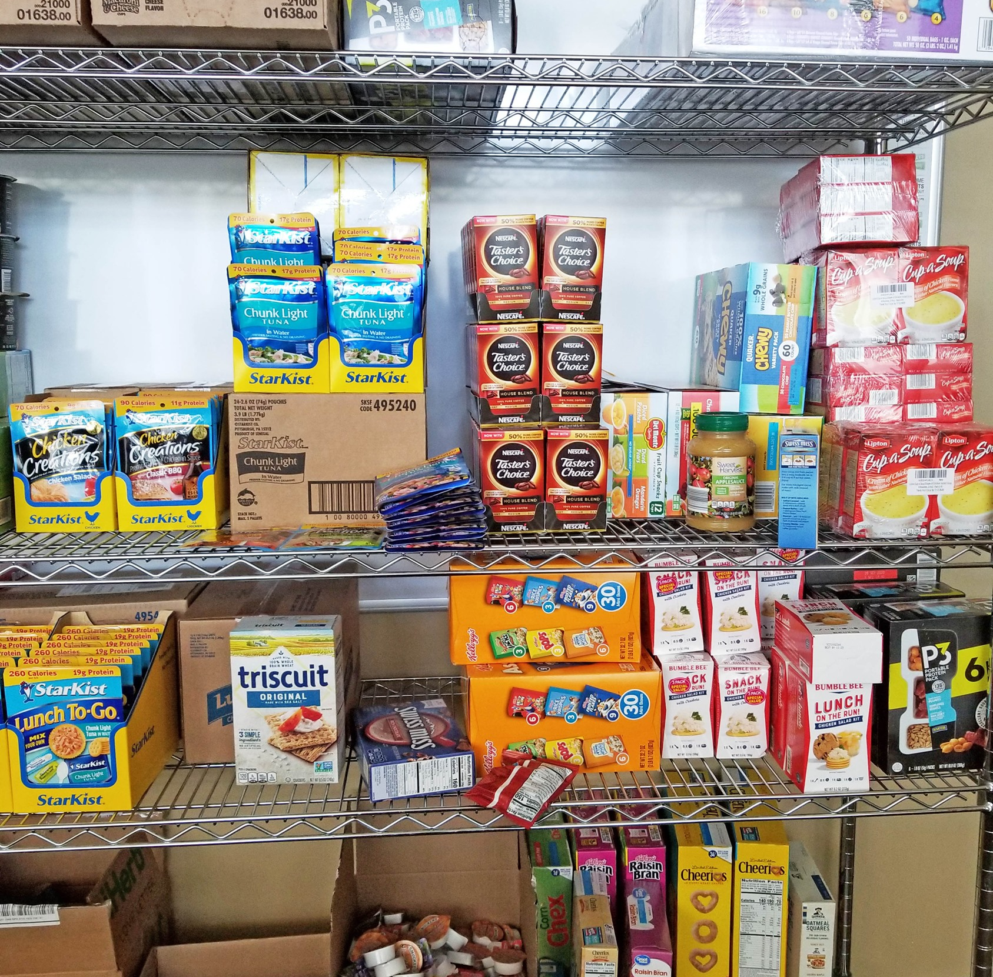
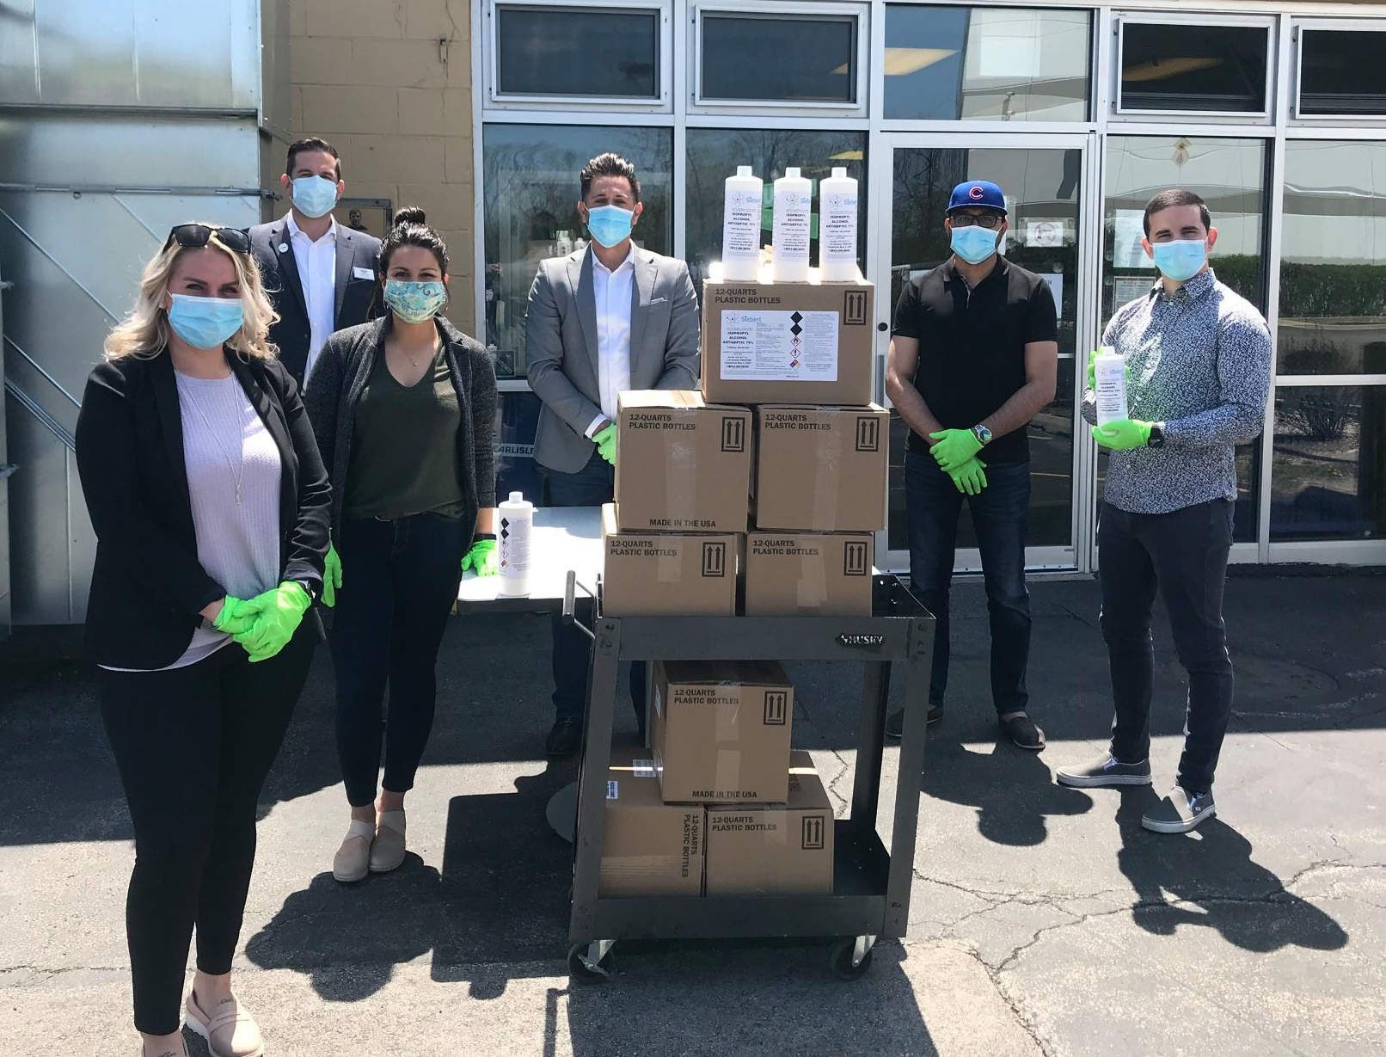
Other Ways to Get Involved:
Matching Grants
Donate time, money, or resources and your company may match you monetarily
Drives & Collections
Seasonal
Clothing Drive
Food Drive
Hygiene Products Drive
School Supplies
Holiday Toys
Toiletries
Gently Used or New Shoes
Giftcards (ex: food, gas, etc.)
3rd Party Events
Bake Sale
Jeans Day at the Office
Care Kit Creation
Penny Wars
Welcome Home Kits

Slide 43
What’s next?
Designate on the Volunteer Information Form link on the next slide whether you’d like to work at the PADS sites, HOPE Center, Delivery Volunteer – or all three!
PADS – Indicate Preferred Site and Shift
The Site will contact you to schedule 1st shift and training
HOPE Center – Indicate area preference & availability
The Volunteer Coordinator will contact you to schedule your first shift and training
Youth Volunteers Need to have Parent Permission Form Signed

Slide 44
Volunteer Background Check Policy
All JOURNEYS’ volunteers are required to participate in a screening process through the Dru Sjodin National Sex Offender Public Website (NSOPW)
A JOURNEYS staff will run the background test for you using this website
Notes:
All volunteers who are at least 18 years of age or older will be screened after attending a JOURNEYS’ volunteer orientation.

Slide 45
Volunteer Information Form (required)
https://journeystheroadhome.kindful.com/register/volunteer-registration-2022

Slide 46
Contact Danielle Kadamian at d.kadamian@journeystheroadhome.org Thank you!
Notes:
Please contact Heidi Meier, Volunteer Coordinator, with any questions at h.meier@journeystheroadhome.org or (847)963-9163 x121

